Slide 1
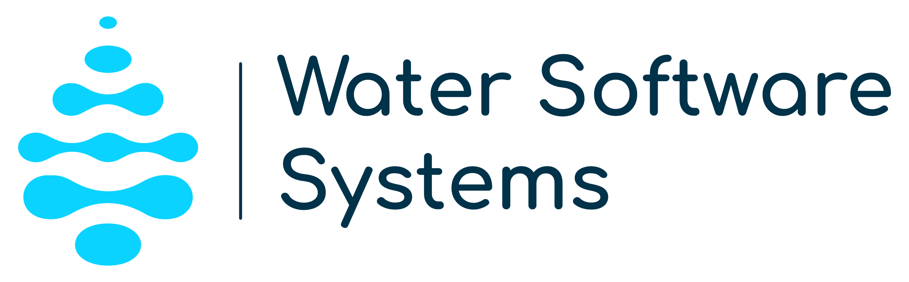

“We provide AI-powered software to water companies for quicker and cheaper leakage detection.”
Notes:
Good morning everyone today I have the pleasure of representing Kegong Diao to introduce Water Software systems and E-favor
We operate on a subscription –based model and also offer training and consultancy services
particularly for water leakage management.

Slide 2

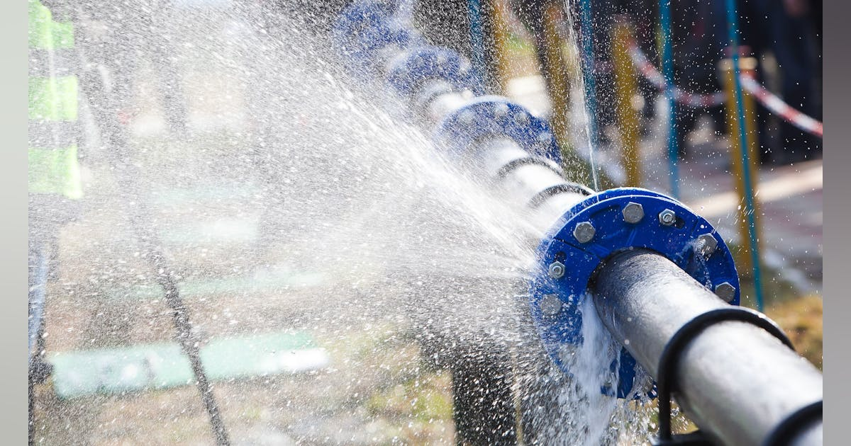



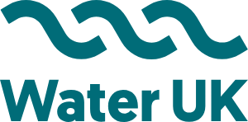
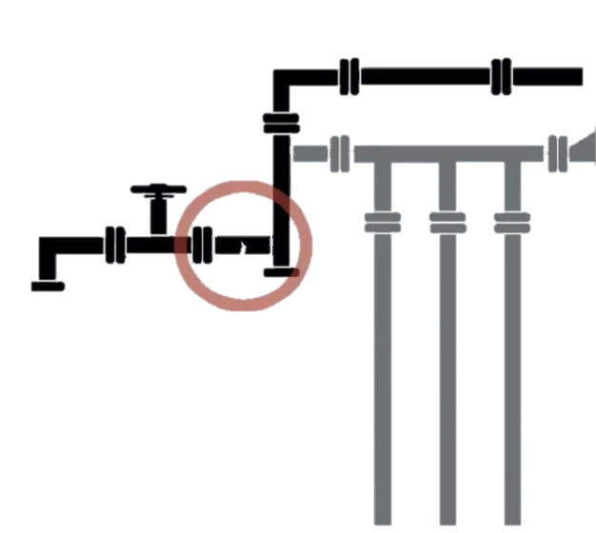
What’s the problem with water leaks?
£ 3.1 billion litres of water lost every day in England and Wales
Water company fined £300 m plus additional penalties
“Over 95% of leaks are never seen by customers.”
“We have set a challenge to water companies to cut leakage between 2020-25 by enough to serve 6 major cities…
“Climate change is increasing the risk of leaks
“Water Demand Target under the Environment Act 2021 to reduce leakage by 31.3% by 2037.”
Notes:
Leakage results in significant water loss and penalties for water companies. This is why both authorities and water companies are committed to reducing leakage.

Slide 3
Why Now?
UK Water Utility Companies are required to:
Triple the rate of leakage reduction by 2030
Leakage Routemap to 2050 (National Infrastructure Commission)
International:
EU: Report leakage level to European Commission by early 2026
China: Targeting at leakage rate <= 10%
Notes:
For instance, water companies are required to reduce the leakage rate by one-third by 2030, and similar regulations apply to their international counterparts.

Slide 4
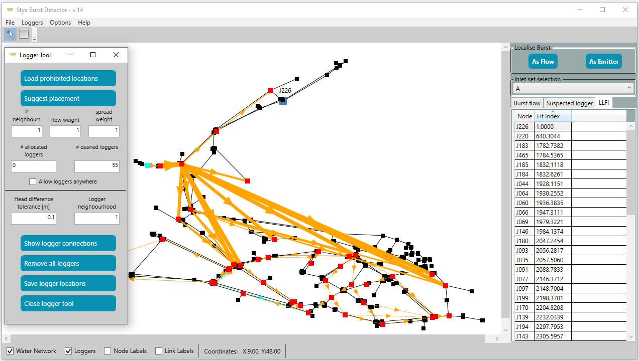
Our solution
Provide information to localise water leaks with minimised intrusions.
(Improved user interface)
1. Logger placement planning & Data collection
2. Identify suspected logger(s)
3. Identify region where the leak locates
4. Localise the leak point
Node
Logger
Logger interactions
Region where the leak locates

Slide 5
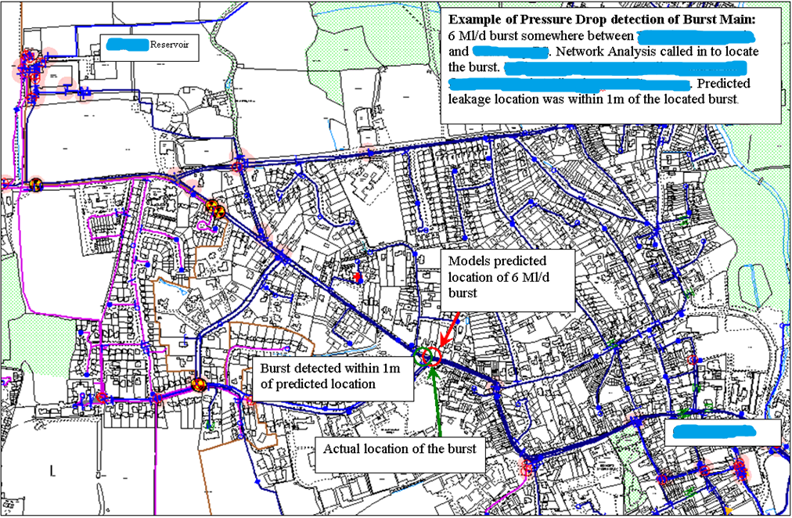
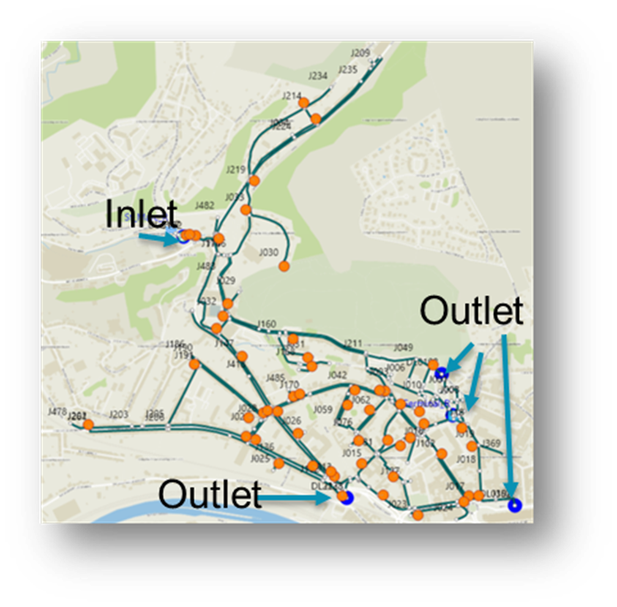
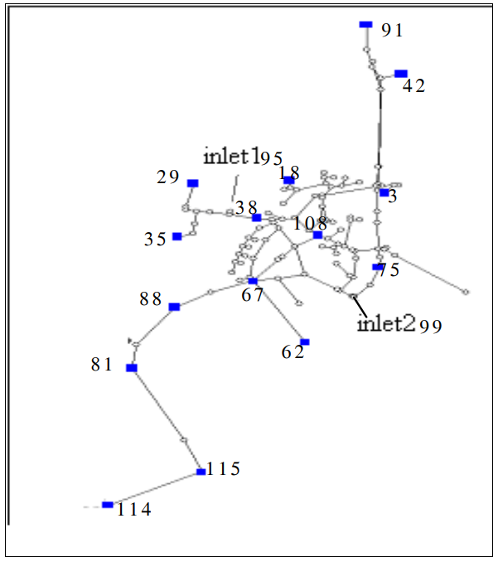
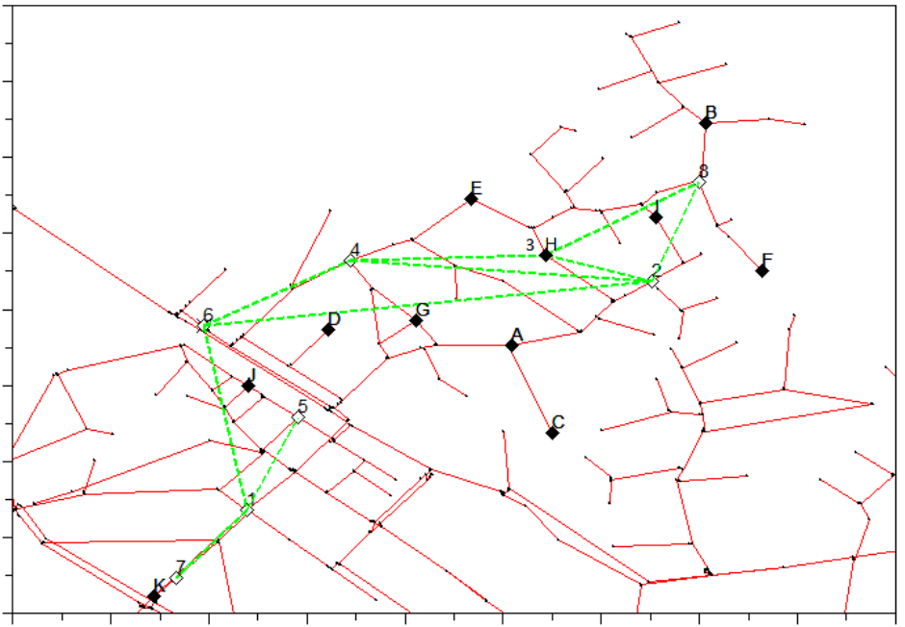
Our solution
Successfully applied in UK Since 2010.
100% success rate.
Detect large range of leak flows, 0.57L/s—69.0L/s.
90 leaks detected in a year.
Notes:
Our solution is a software called E-Favor, which provides crucial information to water companies to localize leaks in their networks with minimal disruption. E-Favor uses hydraulic models and analyzes data from sensors to pinpoint leak locations.
It has been proven to significantly reduce the time needed for leak detection and can identify leaks that other technologies cannot.
What is the true cost of water leakage?
Water leakage poses a multifaceted challenge to the water industry, impacting various aspects ranging from economic costs to environmental sustainability. Understanding these ramifications underscores the urgency of effective leak detection and reduction strategies.
Economic Costs:
Infrastructure Repair and Replacement: Constant water leakage puts a strain on infrastructure, leading to increased repair and replacement costs for pipes, valves, and other components of the water distribution network.
Revenue Loss: Unaccounted-for water due to leakage directly translates to revenue loss for water providers. As water is a finite resource, the financial implications are substantial, affecting the industry’s overall economic viability.
Environmental Impact:
Ecosystem Disruption: Water leakage can lead to changes in local ecosystems, affecting plant and animal life dependent on water sources. Prolonged leakage may disrupt natural habitats, potentially causing irreversible damage.
Energy Consumption: The energy required to pump, treat, and distribute water is significant. When leakage occurs, additional energy is expended to compensate for the lost water, contributing to increased carbon emissions and environmental degradation.
Resource Scarcity:
Water Scarcity: In regions already facing water scarcity, every drop counts. Water leakage exacerbates scarcity concerns, intensifying competition for available resources and necessitating more sustainable water management practices.
Impact on Agriculture: Agriculture relies heavily on water availability. Pervasive leakage can compromise irrigation systems, affecting crop yields and food production.
Public Perception and Trust:
Customer Confidence: Frequent water leaks can erode public confidence in water providers. Customers may become disillusioned due to service interruptions, water quality concerns, and the perceived inefficiency of the water supply system.
Regulatory Compliance: Water providers must comply with strict regulations regarding water conservation and leakage reduction. Failure to meet these standards can result in penalties and further financial strain.
Operational Efficiency:
System Reliability: A water distribution system plagued by leaks is less reliable and efficient. Sustaining optimal pressure levels becomes challenging, leading to potential service disruptions and operational inefficiencies.
Emergency Response: Large-scale leaks can trigger emergency responses, diverting resources and attention from routine maintenance and system improvements.
Social Responsibility:
Community Impact: Water scarcity and environmental degradation affect communities, particularly vulnerable populations. Water providers have a social responsibility to address leakage issues for the well-being of the communities they serve.

Slide 6

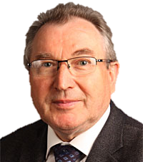
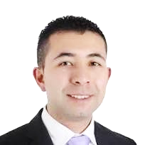

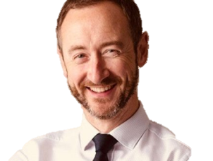
The Team
Technology & Management
Dr. Kegong Diao
Bogumil Ulanicki
Héctor Duque
Research Development
Jim
Willis
Phil Webster
Project Lead
Technology mentor
Utility relationship & Digital product development
Business strategy
Notes:
We have formed a diverse team with expertise in various areas such as:
Utility… maker
Business … adviser
Students
In addition, we are supported by both internal mentors and external industry experts

Slide 7
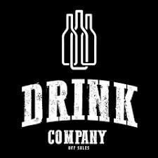


The Market
Target at £ 1 Million
(for Software system)
water companies: UK, EU, China
The global Water Leak Detection Systems market size: £ 1 Billion (2028)

Slide 8



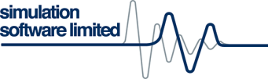



Competition
Providers / Tools | Water utility companies expectations
 | E-Favor |  |  |  | Satellite solutions
100% Accuracy(No randomness) |  |  |  | Unknown | Unknown
Usable by non-experts
High efficiency for large systems (>10,000 nodes)
No more sensor purchases required
Ability to detect small leaks (<1L/s)
Proven under complex situations
Customer growth
Notes:
Of course, there are competitors, however, E-favor has a unique advantage. It has a 100% accuracy rate with no randomness in its results.
Many of our competitors are interested in collaborating with us rather than competing
Additionally, we are the only company with a clear record of customer growth.

Slide 9
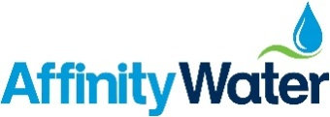


Traction
New partnership:
Two consultancy projects for SWDE, Belgium
Technical verification with the largest water-only supplier in the UK
2011
2012-2016
2017-2019
2020-2022
2023-2024
2012
The birth of E-Favor
TRL4 → TRL 7
Build reputation:
Two consultancy projects in Sri Lanka and China
Internal investment £13,400
Internal investments:
£8000
Three external grants for further development & knowledge transfer
British Academy,
British Council
The Federal Ministry of Agriculture, Forestry, Regions and Water Management, Austria
So far we've had 100% success with the e-Favor method. Rolling out it from 30 regions to 100 regions!
Save 400m3 water per leak point per year.
£72k/year savings with 90 bursts per year
Notes:
Founded in 2011, we worked with the largest water supply company in the UK, achieving technical verification and reaching TRL7.
This demonstrates our 100% success rate. Since then, we have built our reputation through consulting projects and received both internal and external funding, including several grants for further development

Slide 10
Business Model
A software licence-based service package for the UK and international markets (UK -> EU -> China -> Worldwide).
Software licence to water companies
£15,000 per year (with reference from other products)
£20,000 per two years.
Inclusive of Software upgrade, maintenance and training.
Pay per use (other clients, e.g. councils, landlords, researchers)
Income sources
Notes:
Our business model primarily relies on software licensing, complemented by paid training and consultancy.
Starting in the UK, we aim to expand worldwide

Slide 11
Revenue growth
Notes:
We are very modest in, 10 times * 2-3 million
With this conservative estimation, we expect to reach half a million in revenue within three years.

Slide 12

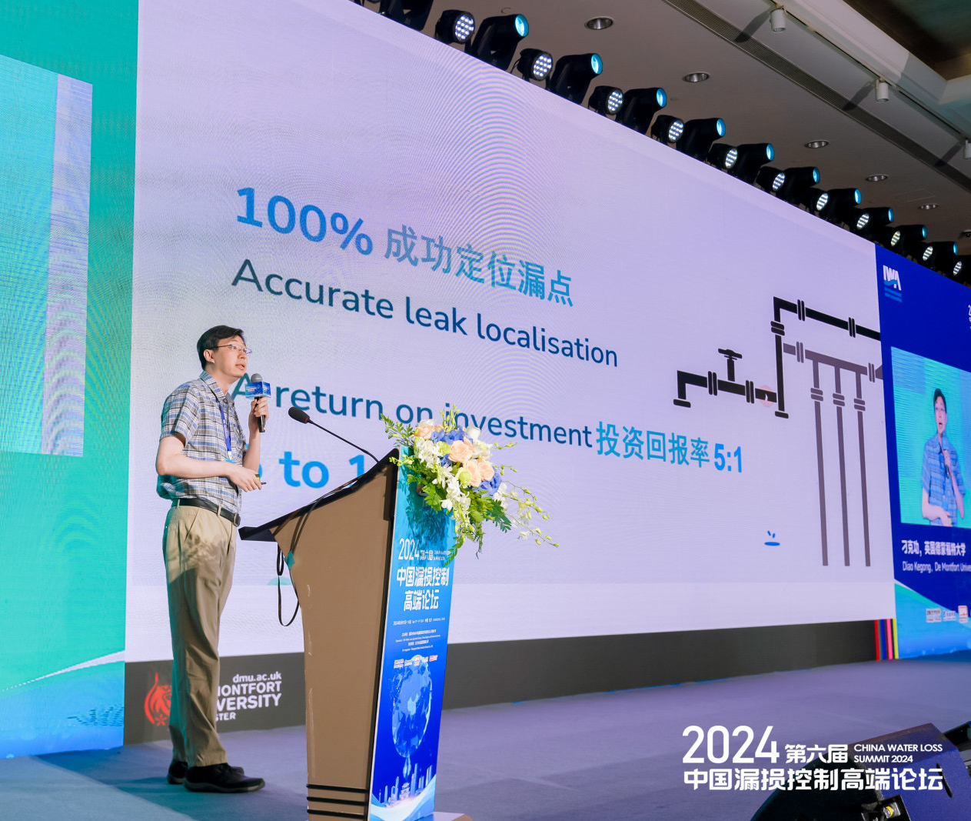

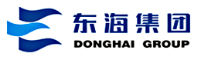
Progress
Substantial progress has been made via the VentureVersity Fund:
Invited meetings with
A major UK water company
International drink company
Jacobs
Four grant applications (e.g. EU Horizon Europe )
10+ new potential customers developed
Notes:
Thanks to the VentureVersity grant, we’ve made substantial progress. By attending various industry events we have been approached by over 10 potential customers, including water companies, water meter suppliers, and consulting firms, all interested in consultancy and feasibility study.

Slide 13
Investment Ask
•£65,000/yr.: For hiring an exclusive business development manager
•£70,000/yr.: For a Research Fellow with strong programming skills
•£15,000/yr.: For running an Agency in China
Return of Investment: 5 to 1
• Follow-on investment: Business expansion including Agency in the EU
Notes:
We’ve also improved E-Favor's software capabilities,
enhanced its user interface,
and created promotional materials, such as the video we’ll show you today.

Slide 14


Thanks for your attention!
Dr Kegong Diao
Senior Lecturer in Engineering and Sustainable Development
kegong.diao@dmu.ac.uk

