Slide 1
EcoSENSE
Real-time monitoring of our environment to prevent dangerous and costly pollution
Notes:
Hello. I am Sarah from EcoSENSE [slide].

Slide 2
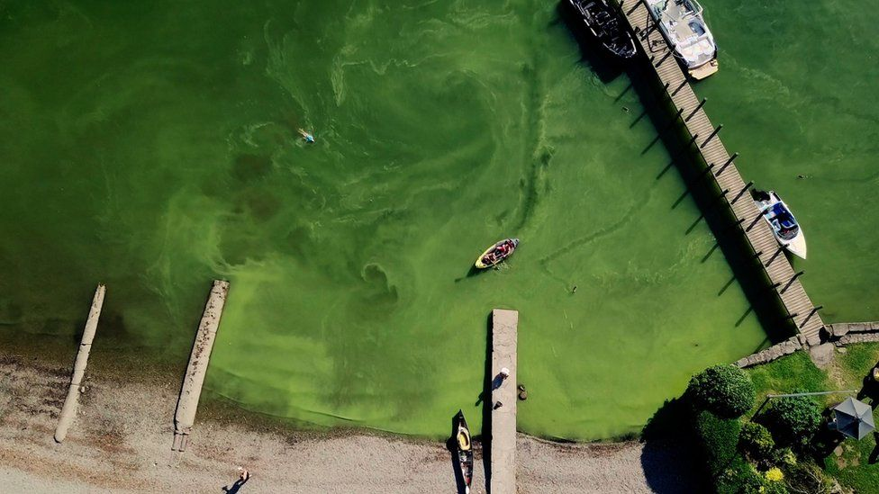
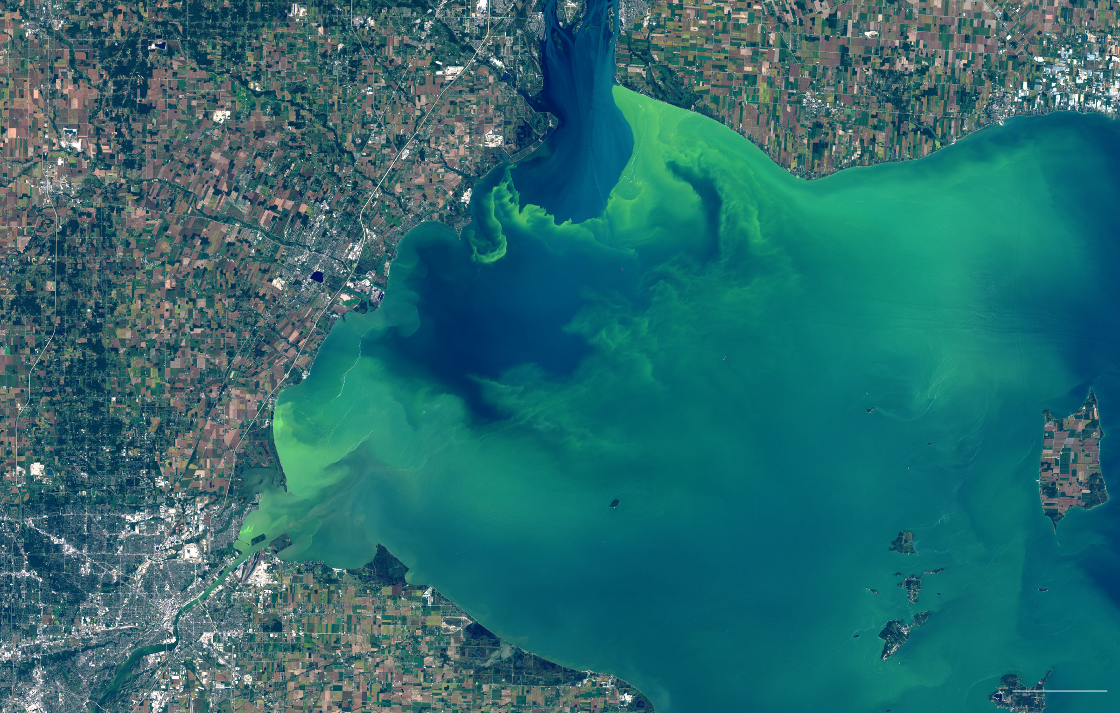
02
The Big Problem
EcoSENSE
Climate change and human activities are damaging our water systems by increasing pollutants
Lake Windermere, Lake District, UK
(May 2024)
Drinking water disruption for 400,000 people
60 hospitalisations
Millions in revenue losses for tourism dependant businesses
Lake Erie, USA (2014)
5 miles
Notes:
Climate change and human activities are increasing pollution in our water systems. Excess nutrients, vital for life, when left unchecked can become destructive by feeding harmful algal blooms. These blooms are a problem all over the world, including the UK, leading to dead zones in water systems and liver failure in humans. Toxins from these blooms have also entered the water supply. This happened in Ohio in 2014, where half a million people were without water for 3 days.
Prevention is paramount, once these are visible, it is already too late.
https://www.ewg.org/research/high-cost-of-algae-blooms
https://www.nwf.org/-/media/PDFs/Regional/Great-Lakes/The-Impacts-of-Lake-Eries-Harmful-Algal-Blooms-on-Great-Lakes-Businesses-v3-062821.pdf
https://www.nytimes.com/interactive/2017/10/03/science/earth/lake-erie.html

Slide 3
03
Current Sensing Technology
EcoSENSE
Lack of reliable technologies that can directly measure key nutrients without using wet chemistry.
Laboratory testing
On-site testing
Ion-selective electrodes (ISEs)
Colorimetric methods
Expensive
Time consuming
Low frequency
Direct exposure to toxic chemicals
Waste creation
Calibration drift
Interference chemicals
Notes:
Effect prevention starts with accessible and reliable monitoring providing timely alerts before damage occurs. Unfortunately, current solutions fall short. Traditional lab-based testing is expensive, slow, and lacks the frequency needed for accurate real-time insights. While on-site testing technologies offer higher frequency, they come with compromises: either accurate results that rely on toxic chemicals or non-toxic options that sacrifice accuracy.
https://www.istockphoto.com/illustrations/inaccurate

Slide 4
04
Solution
Upgrade current on-site monitoring products with cutting-edge sensing technology.
EcoSENSE
Realtime Feedback
Safe solution
Multi-sensing
Rapid and reliable data, without the waiting time
Dual encapsulation technology
Detect multiple pollutants simultaneously
Notes:
The solution is to upgrade current on-site monitoring products with cutting-edge sensing technology. A technology that offers rapid and real-time data, no direct exposure to harmful chemicals and the ability to identify numerous avenues for pollution.

Slide 5
Sensor Encapsulation
EcoSENSE
Patented process for securely immobilizing sensing molecules within a versatile hydrogel.
Sensing Material
Fluoresces when in contact with pollutant(s).
Quantifiable signal.
E.g. Lateral Flow Device or Dip Stick
05
Product
Notes:
We have developed a patented process that encapsulates active molecules capable of detecting specific pollutants. The versatile hydrogel material can be easily manipulated to embed within current technologies.

Slide 6
Sensor Encapsulation
EcoSENSE
Patented process for securely immobilizing sensing molecules within a versatile hydrogel
Sensing Material
Fluoresces when in contact with pollutant(s)
Quantifiable signal
E.g. Lateral Flow Device or Dip Stick
05
Product
Notes:
This video shows how the smart material emits light when exposed to specific pollutants with light intensity easily quantified. This technology could help detect harmful algal blooms well in advance of an outbreak.

Slide 7
Why Now
06
Feedback from Water Management Companies
Legislation changes
“75% of our existing clients would want to add a sensor to the units they already have”
“We want to take your sensing element and integrate it into a full system that could be deployed into the water”
Mandating a 'Sustainability statement' in certain business financial reports
E1 – Climate Change
E2 – Pollution
E3 – Water & Marine Resources
E4 – Biodiversity & Ecosystems
E5 –Resource Use & Circular Economy
“Low-cost sensing is the Holy Grail for the water industry”
EcoSENSE
Notes:
We have spoken with water management companies, who have highlighted the need for real-time, on-site monitoring of specific pollutants. Here are some quotes taken from these discussions. Environmental threats are prompting stricter regulations like the EU’s Corporate Sustainability Reporting Directive (CSRD), which will mandate greater accountability for environmental impact.

Slide 8
07
Size of Market
EcoSENSE
$5.6B
(2023)
$1.2B
$35.9M
Total Available Market
Serviceable Achievable Market
Serviceable Obtainable
Market
The global market for water quality sensors is projected to grow to USD $10.8B by 2032 (CAGR = 8.5%).
Europe and America – 1M open water lakes (≥1 he).
UK – 15,000 storm overflow points
Water monitoring device manufacturers also service other industries, including maritime compliance, aquaculture, and wastewater.
Notes:
The water quality sensor market was valued at $5.6B in 2023 and is projected to reach $10.8B by 2032. If half of the 1M lakes in Europe and North America contain a water monitoring device our serviceable achievable market is $1.2B, If we were to provide sensing products for the 15,000 storm overflow points just in the UK, the serviceable obtainable market would be $35.9M. However, as water monitoring device manufacturers often service a variety of different sectors and our platform technology is well suited to other monitoring applications, the market size is probably much larger.

Slide 9
Competition
08
EcoSENSE
How do we Compare?
 | Portability | Manufacturability | Lifecycle | Cost | Data Acquisition | Ease of Operation | Additional Functions | Autonomous Ability
EcoSENSE technology
Lab-on-disk (colorimetric)
ISE electrochemical
Biosensors
Notes:
This table compares the key features for monitoring methods used by water treatment companies. It highlights how EcoSENSE will compete on features that matter to consumers. Our device has more green ticks, with further R&D required in some areas.

Slide 10
09
Business Model
EcoSENSE – a manufacturer and supplier of smart sensing materials
A solution-based licensing model within a B2B framework
In partnership with water monitoring device companies who will manufacture and supply the final product.
Nov 24 – Mar 25
Secure funding
Industrial test partners found
Prototype designed
University permissions obtained for spin out
Mar 25 – Mar 26
Initial prototype mock-up
Infield trials (loop)
Product validation
[Spin out year 1-2] Mar 26 – Mar 28
First sales mid-28
EcoSENSE
Notes:
EcoSENSE will operate as a manufacturer and supplier of smart sensing materials. By leveraging a solution-based licensing model, water monitoring device companies will produce the final product. Our roadmap begins with securing funding to design a prototype and gain university approval to spin out a company. Post-spin-out, we will focus on prototype development, in-field trials, and aim for first sales by mid-2028.

Slide 11
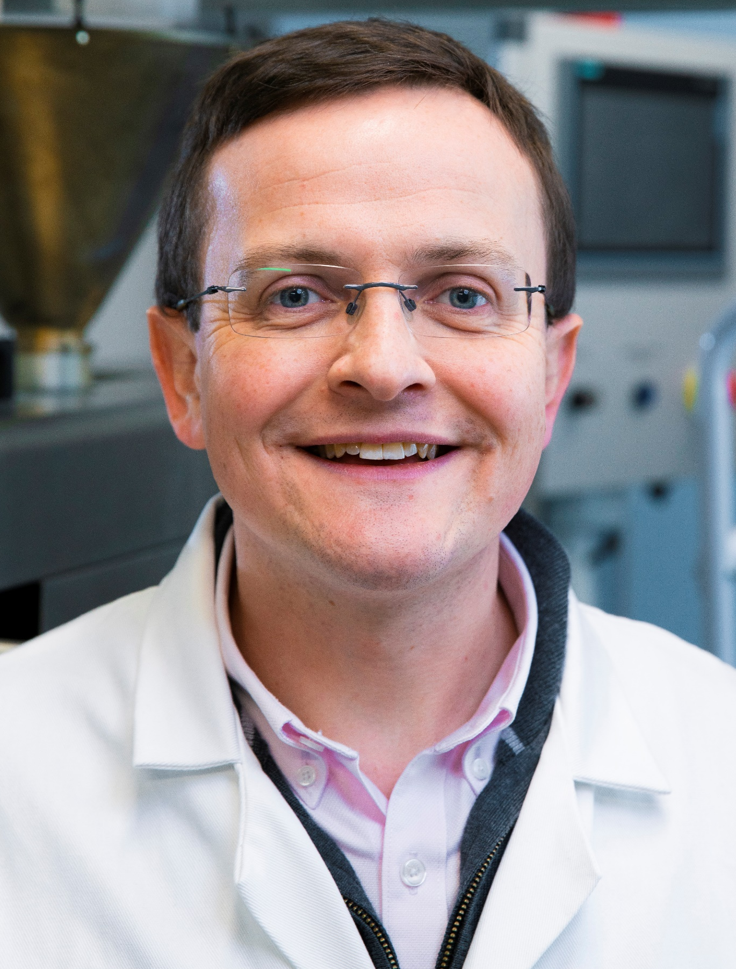
10
Meet the Team
EcoSENSE
Dr Sarah Woods
CEO
Materials Scientist with
drive to build a business
Dr Helen Willcock
Technical Director
Functional materials
expert
Dr Stephen Butler
Technical Director
Developing brand-new molecular sensors
Dr Roshna Mistry
TTO
Commercialising university technologies
Dr Chris Kay
Strategic Advisor
Founder/CSO of
spin-out company
currently scaling up
Notes:
I am an enthusiastic polymer scientist with experience working in early-stage companies. The inventors are Helen, an expert in functional materials, and Stephen, who develops new molecular sensors. Roshna, our technology transfer officer, is well-versed in enterprise and commercialising university technologies. Chris is our business advisor and is the founder of his own spin company which is upscaling a similar process to EcoSENSE.

Slide 12
11
Traction
Loughborough University-backed
– PoC, IP Protection, 5 current PhD research students
TRL4-5
Scale up PoC
Customer Validation
Med-Tech – High Risk, Long Path, Many Regulations
(Medical devices, Point-of-care, Biosensing, Blood electrolyte monitoring)
Medical Devices
Diagnostics PoC
EcoSENSE
Notes:
We have secured substantial funding from Loughborough University to patent our technology, establish a multi-departmental research collaboration, and conduct proof-of-concept studies with industrial partners, including scaling the manufacturing process. Through the ICURE and VentureVersity programs, we’ve also validated our technology with potential customers, including those in the MedTech sector.

Slide 13
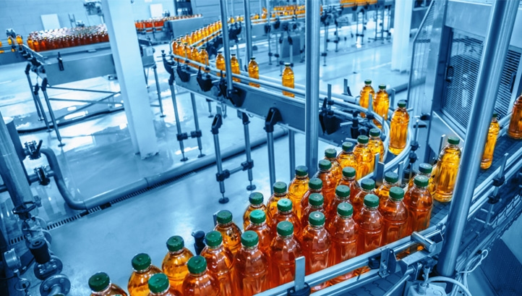
The biggest successes
Gained a
- motivated lead
- business advisor
New collaborations opportunities …..
- environmental research institution
- large personal care manufacturer
- environmental sensor manufacturer
EcoSENSE
Defence
Medical Devices
Food & Drink
Water Monitoring
Wearables
12
VentureVersity Journey
Notes:
60 meaningful conversations, 5 industries, 4 events. There have been many successes throughout the VV programme and just to highlight a couple. The EcoSENSE team has expanded with myself, and Chris now committed to this project. There are also three NDA agreements currently being set to begin new collaborations.

Slide 14
13
Ask
Secure funding
The EL’s salary ends on 28th February 2025
Collaborators
Industrial test partners
Expertise
Financial contribution
£500,000 for spin-out in its initial 12 months (March 2026)
Set up lab facilities and business headquarters
Facilitate further PoC work
Recruit a research scientist
Easy to Prepare
Rapid data
Reversible Sensing
Tuneable
Flexible
Notes:
As the development of this exciting new technology accelerates, we seek funding to launch and sustain a spin-out company, partners to help drive the project forward, and £500K to execute our business plan, paving the way to our first sales. Thank you for your time!

