Slide 1
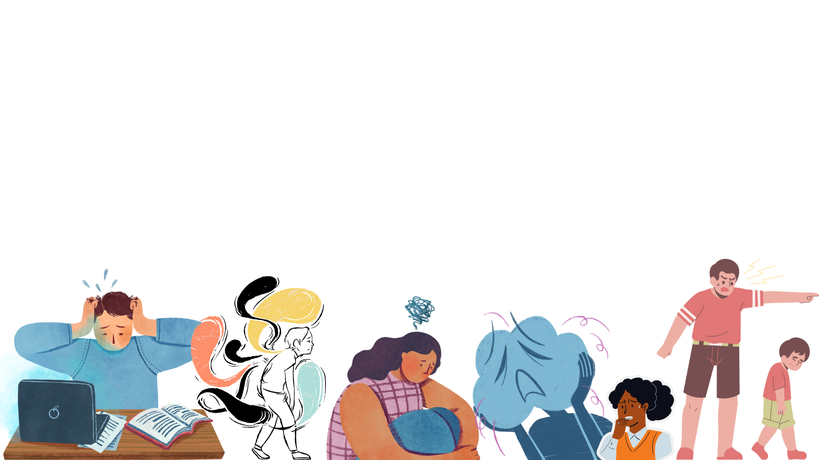
Building Resilience in Children (BRIC)
At BRIC we build resilience in children
We create and sell bespoke workshops, board/digital games to Parents, Educators and Caregivers.
A subscription-based service accessible from our online platform
Dr Indrani Lahiri, Founder Director

Slide 2
Problem:
Resilience in children is at all time low, particularly after the pandemic
20.3% of eight to 16-year-olds had a probable mental disorder in 2023
Teachers, Parents and Caregivers feel lost (don’t have skills and capacity)
No holistic solutions to tackle the problem- support fragmented and difficult to access
Notes:
By talking with parents, teachers and carer givers, I now know there are problems. We can’t address all the problems, so I have broken it down to 5 problems that were repeatedly highlighted in interactions.
Summarise

Slide 3
Why Now:
1 in 5 children aged 5-16 experiencing mental health problem (NHS, 2023)
7250 UK students - social, emotional, and behavioural difficulties
1.5 million children and young people under the age of 18, and 8.5 million adults

Slide 4
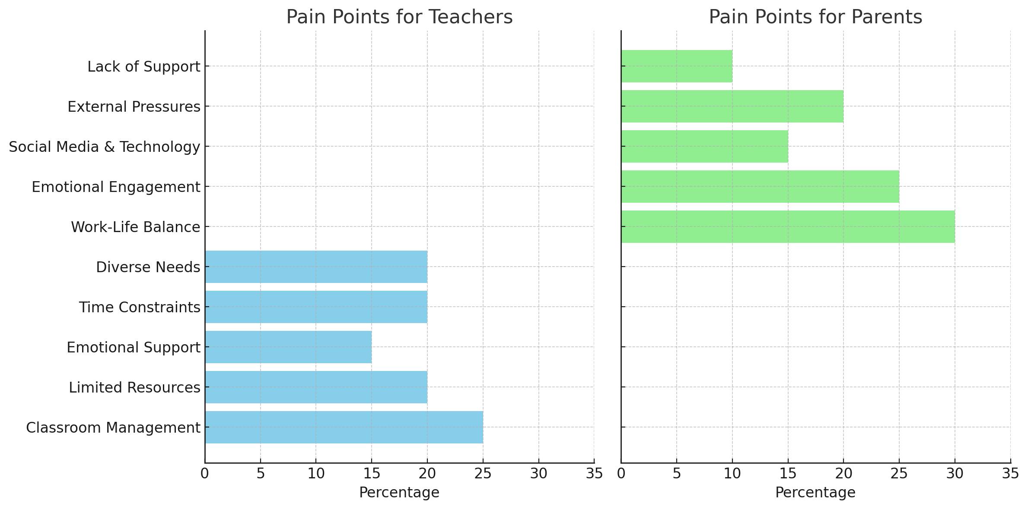

Slide 5
Solution:
BRIC is the solution offered by a freemium model
Free open-source resilience building content
Gamifying the curriculum to mainstream resilience building
Notes:
S1: Digital content on our website
S2:Develop partnerships
S3+S5: Develop tools and techniques
S4:Gamify curriculum

Slide 6
Product: Online platform (Freemium)
BRIC an online platform delivering
Workshops
Board Games
Consultancy
Notes:
teachers, children, parents and caregivers

Slide 7
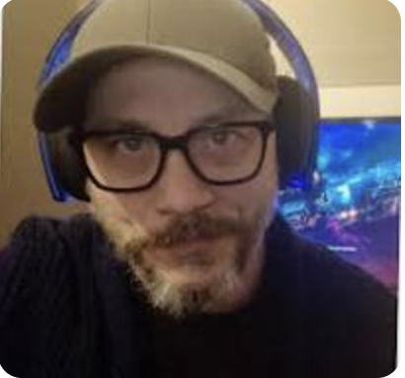
The Team and Supporters:
Media Subject matter Expert
Graphic Designer
Psychologist
Computer Scientist
Game Developer

Slide 8
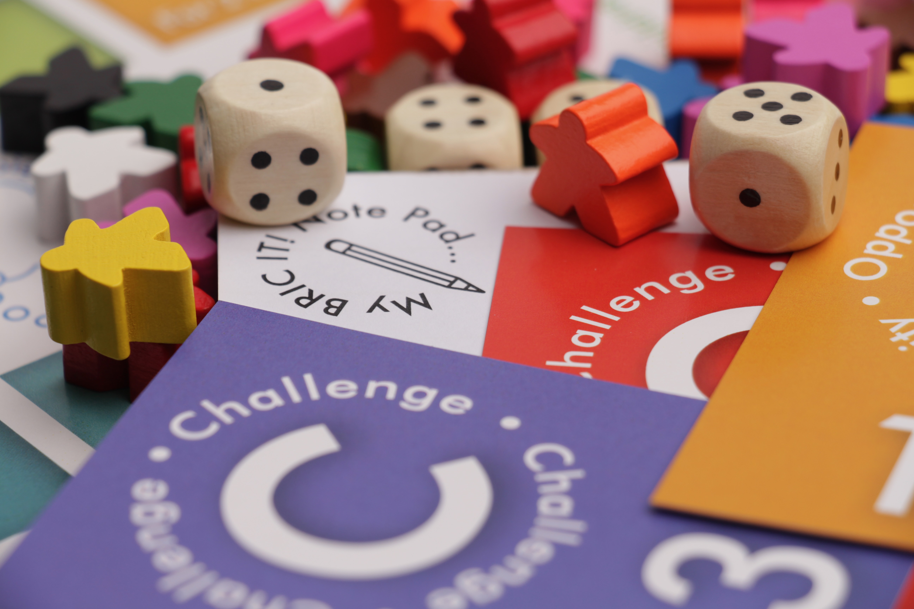
Population of Leicestershire (2021 estimate): Approximately 706,155
Estimated aged 8-12 in Leicestershire: Approximately 42,369 (6% of total population)
Potential revenue calculation:
Assume average price per child per year: £150 (for workshops/games)
TAM = 42,369 × £150 = £6,355,350 per year
Notes:
Target Age Group: Children aged 8-12
Population of Leicestershire (2021 estimate): Approximately 706,155
Estimated number of children aged 8-12 in Leicestershire: Approximately 42,369 (6% of total population)
Potential revenue calculation:
Assume average price per child per year: £150 (for workshops/games)
TAM = 42,369 × £150 = £6,355,350 per year

Slide 9
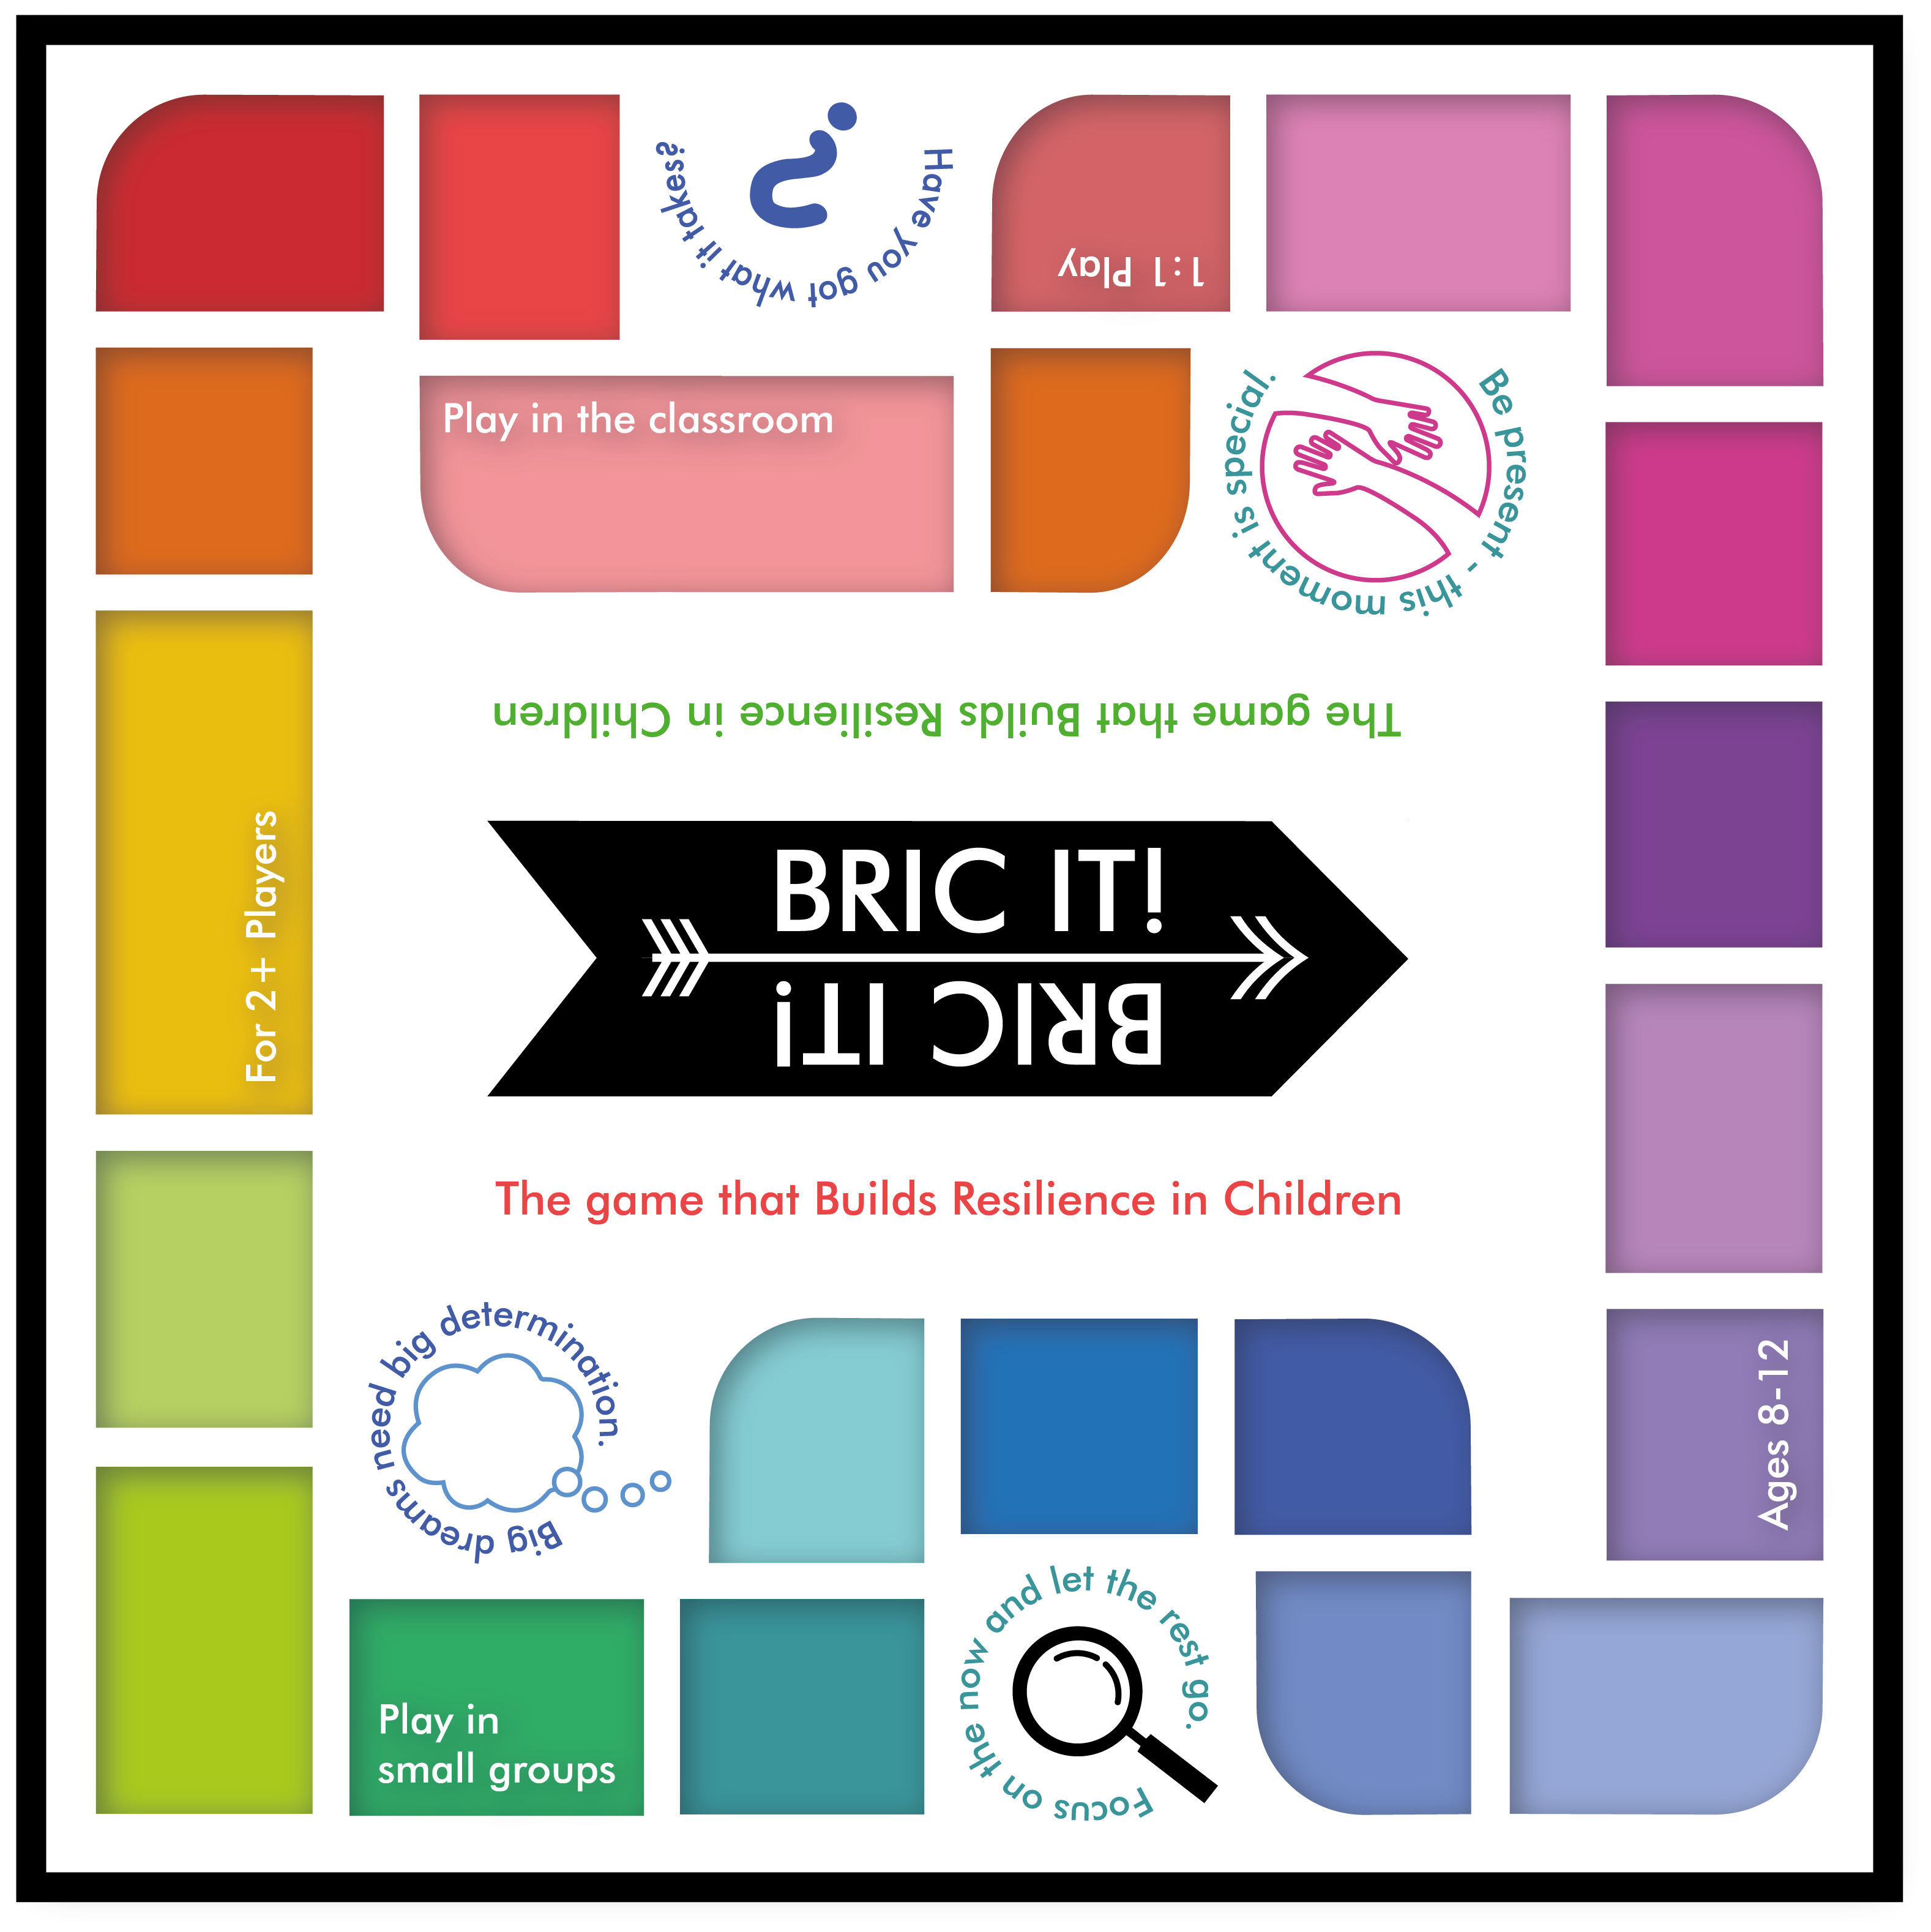
No. of schools in Leicestershire: 280
50% interested : 140 schools
50 students per school in the age range: 7,000
10% of 42,369 parents: 4237 students
15% of 50 community centres: 7
Potential reach: 11,244 children
Potential revenue: 11,244x£150= £1,686,600
Partnerships with local authorities and educational institutions could be crucial for market penetration.

Slide 10
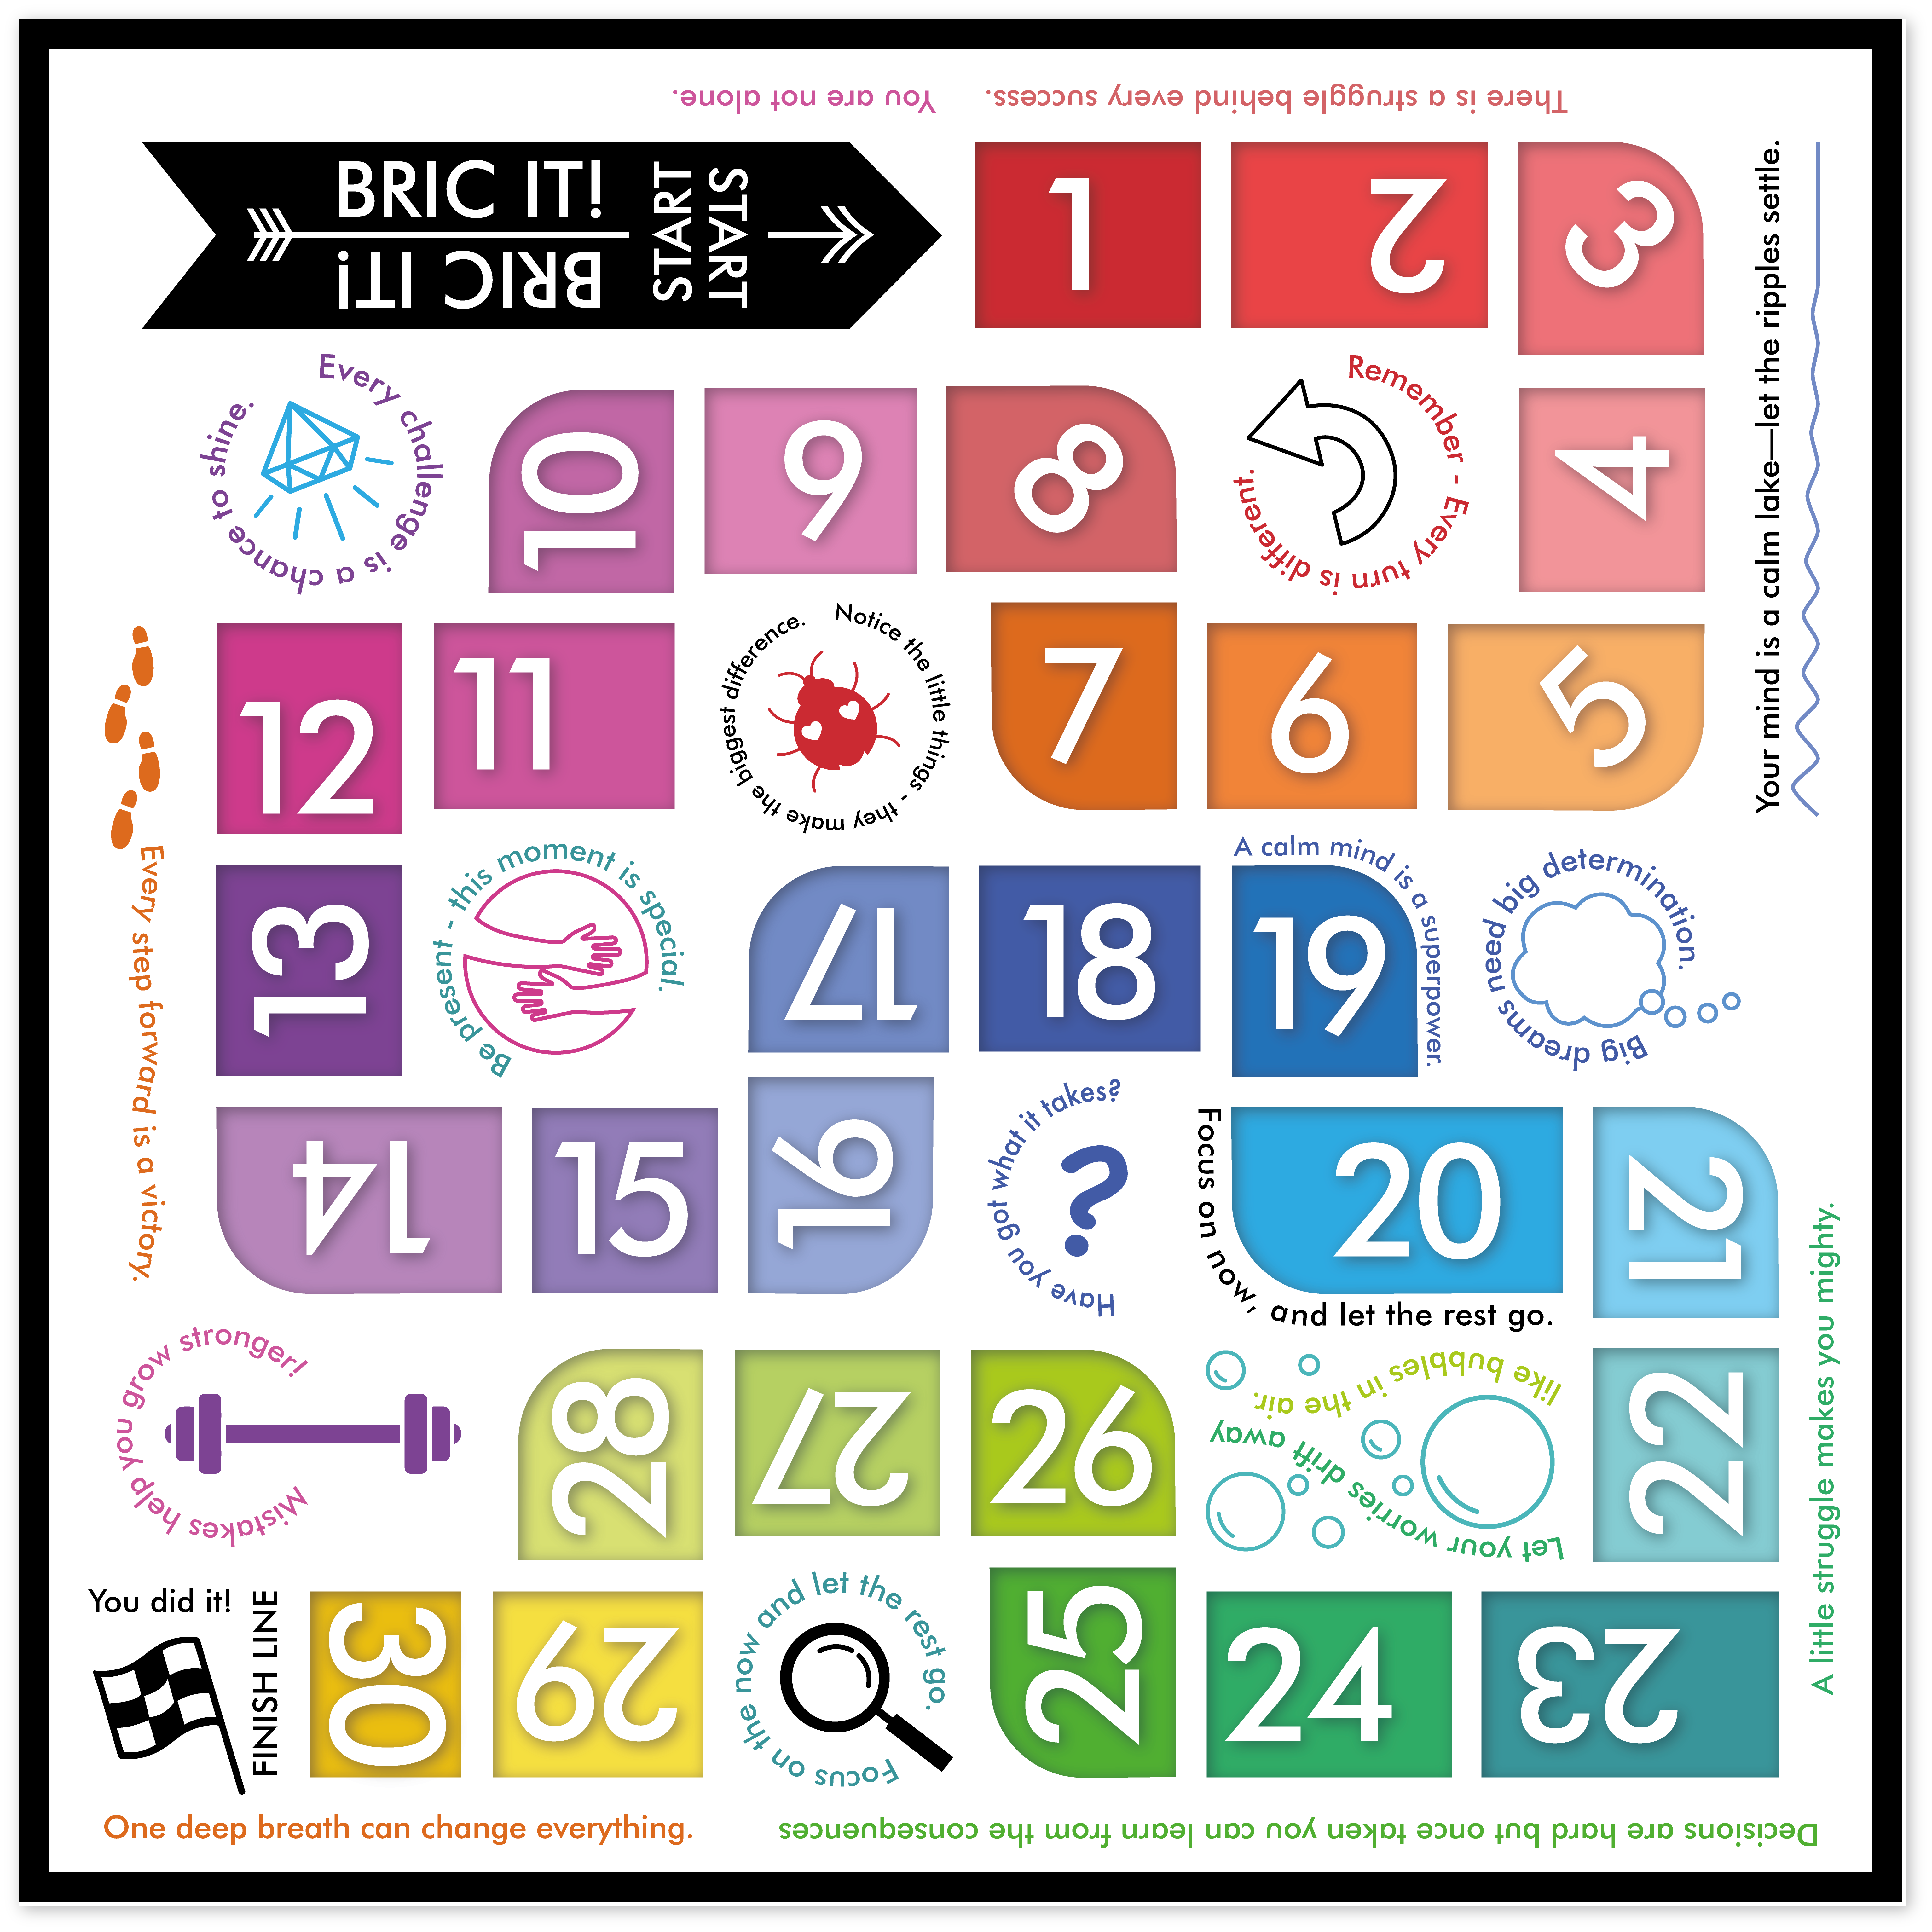
Group sessions for educators and children
Advice and guidance for educators for bespoke solutions
Talks promoting mental health
Written documents
BRIC
Benefits/products
Gamifying curriculum to make it more accessible
Web-based resources for parents
Curriculum Worksheets
Information
Web-based resources for parents
Curriculum Worksheets
Information
Competition:
Tailored Programming for:
Educators
Parents
Children
Competitors but potential collaborators/ customers of BRIC!
Industry standard services provided in collaboration with experts
Workshops delivered for teenagers in school
Educational Workshops in schools in Northamptonshire
Curriculum led Enrichment Programs
Notes:
We know that they are competitors but we are the only one providing the one stop shop
Why better?

Slide 11
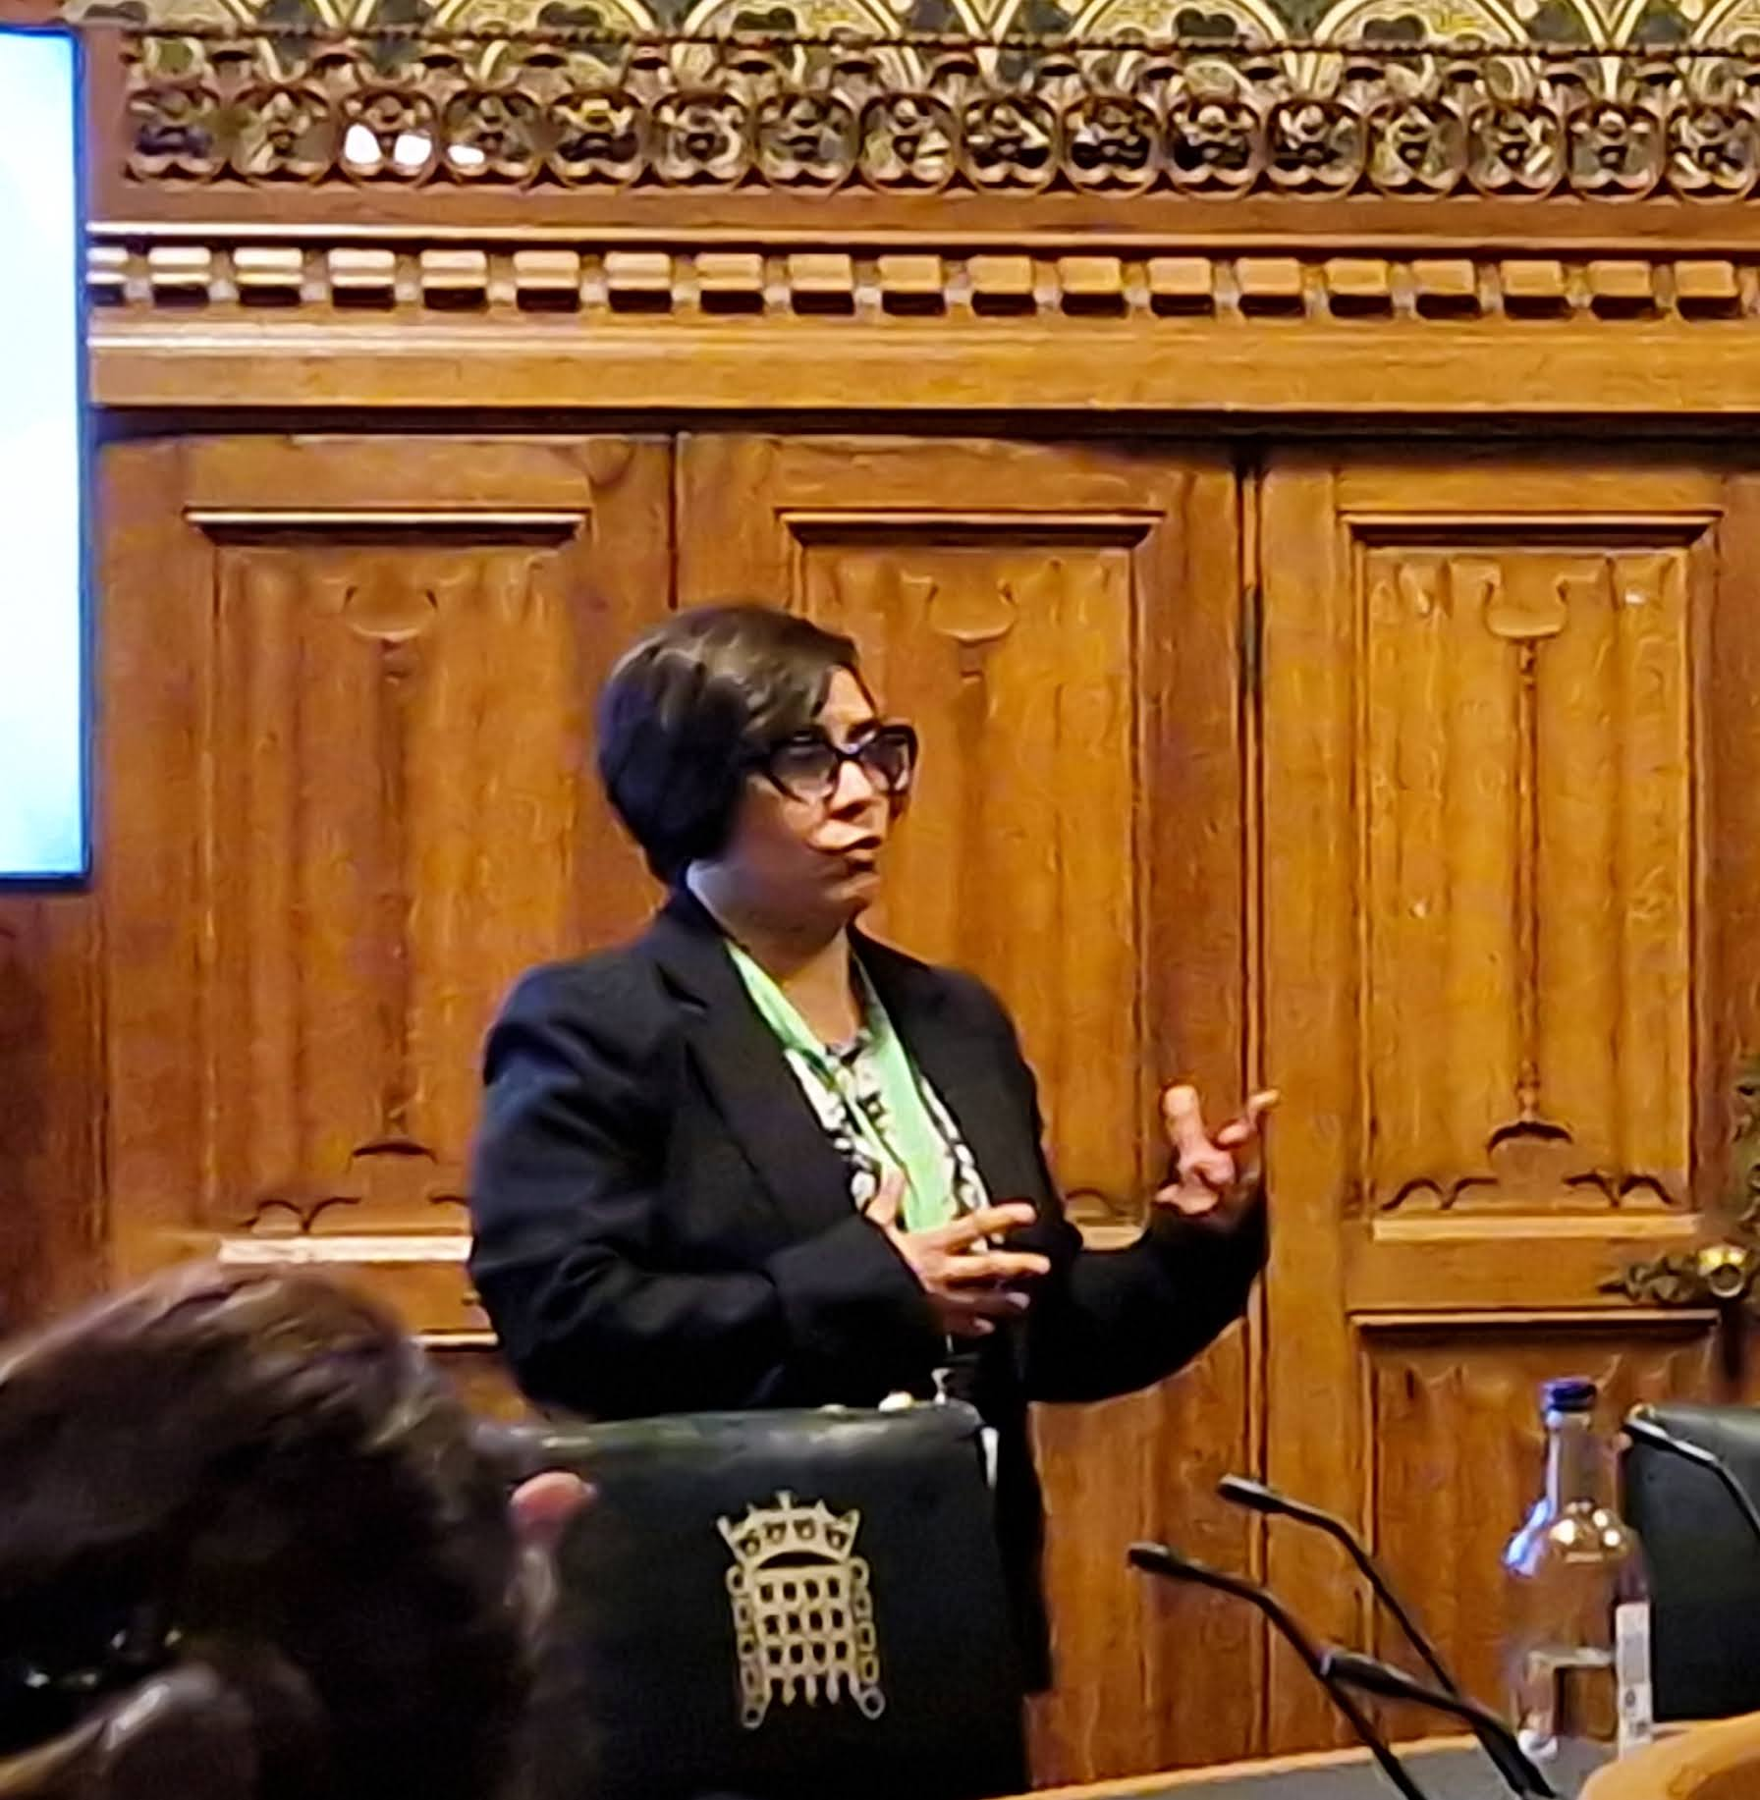
Traction:
Received HEIF funding (~£14K)
DMU Frontrunner (2023-24 and 2024-25)
Established CIC (April 2024)
Market validation (7 Workshops delivered)
Product/service validation: (Welltech medical, schools)
Platform testing (103 unique visitors, 188 site sessions)
YouTube channel established: 1,600+ subscribers (Dec 22 to date)
Google surveys (2 surveys to determine market pull)
Invited talk at the Parliament (February 2024)
Ventureversity (£18,000)
Ongoing discussions with the following prospective collaborators/customers
Welltech medical
Leicester NHS Trust
National Space Centre

Slide 12
Business Model:
Subscription based (schools, parents, caregivers)
Freemium (schools, parents, caregivers)
Partners and Collaborators
Licensing (competitors)
Potential Christmas booking for 4days at Wesley Hall for 100 children per day at Youth Club.

Slide 16
8-12 year Resilience Game Hub

