Slide 1


Leyshon Griffiths
Liz Anderson
Improve patient safety and culture in the NHS
trlg1@le.ac.uk

Slide 2
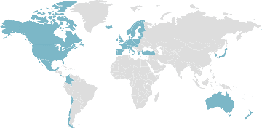

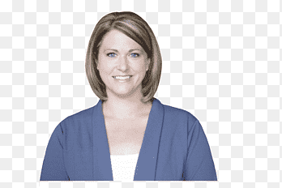
Problem:
1 in 10 patients are harmed in healthcare
40% are preventable
£8 billion per year spent on preventable harm
11,000 deaths per year are avoidable
35/1,900 patient safety incidents per day result in severe harm or death
Meet Alice
Current data fails to explain exactly what’s going on
Some teams are reluctant to speak up
Learning is mostly focused on what went wrong (Safety-I)

Slide 3
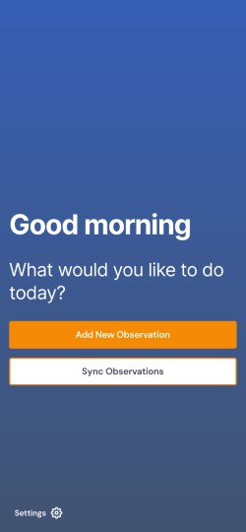
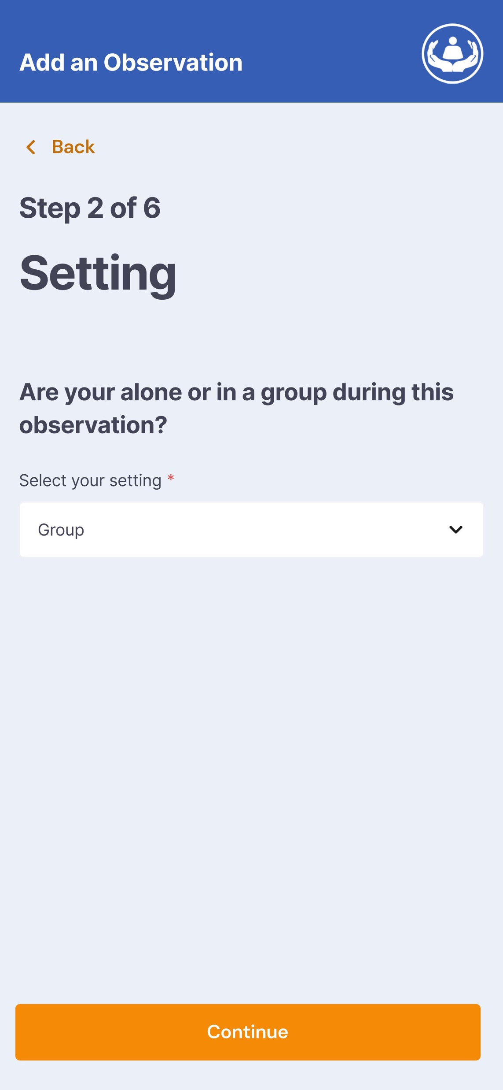
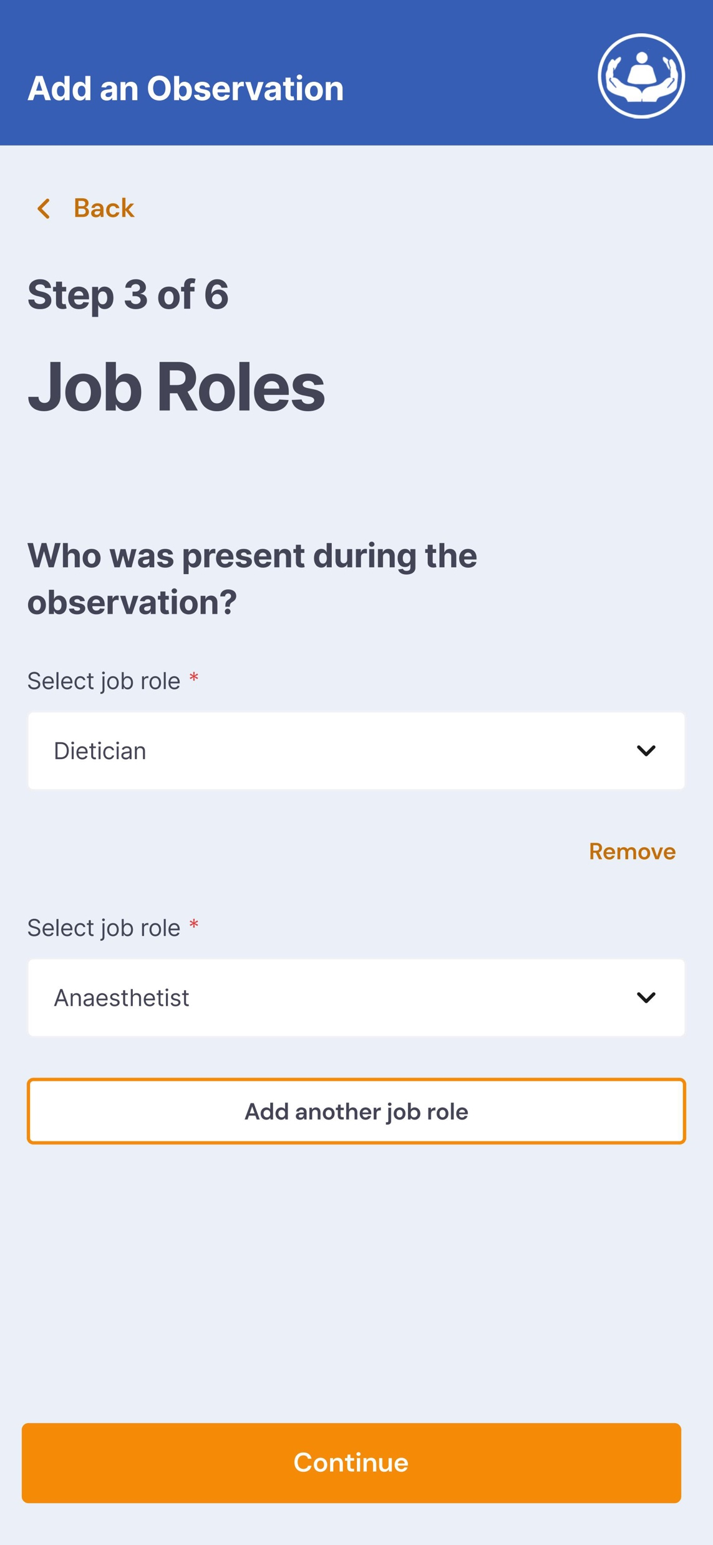
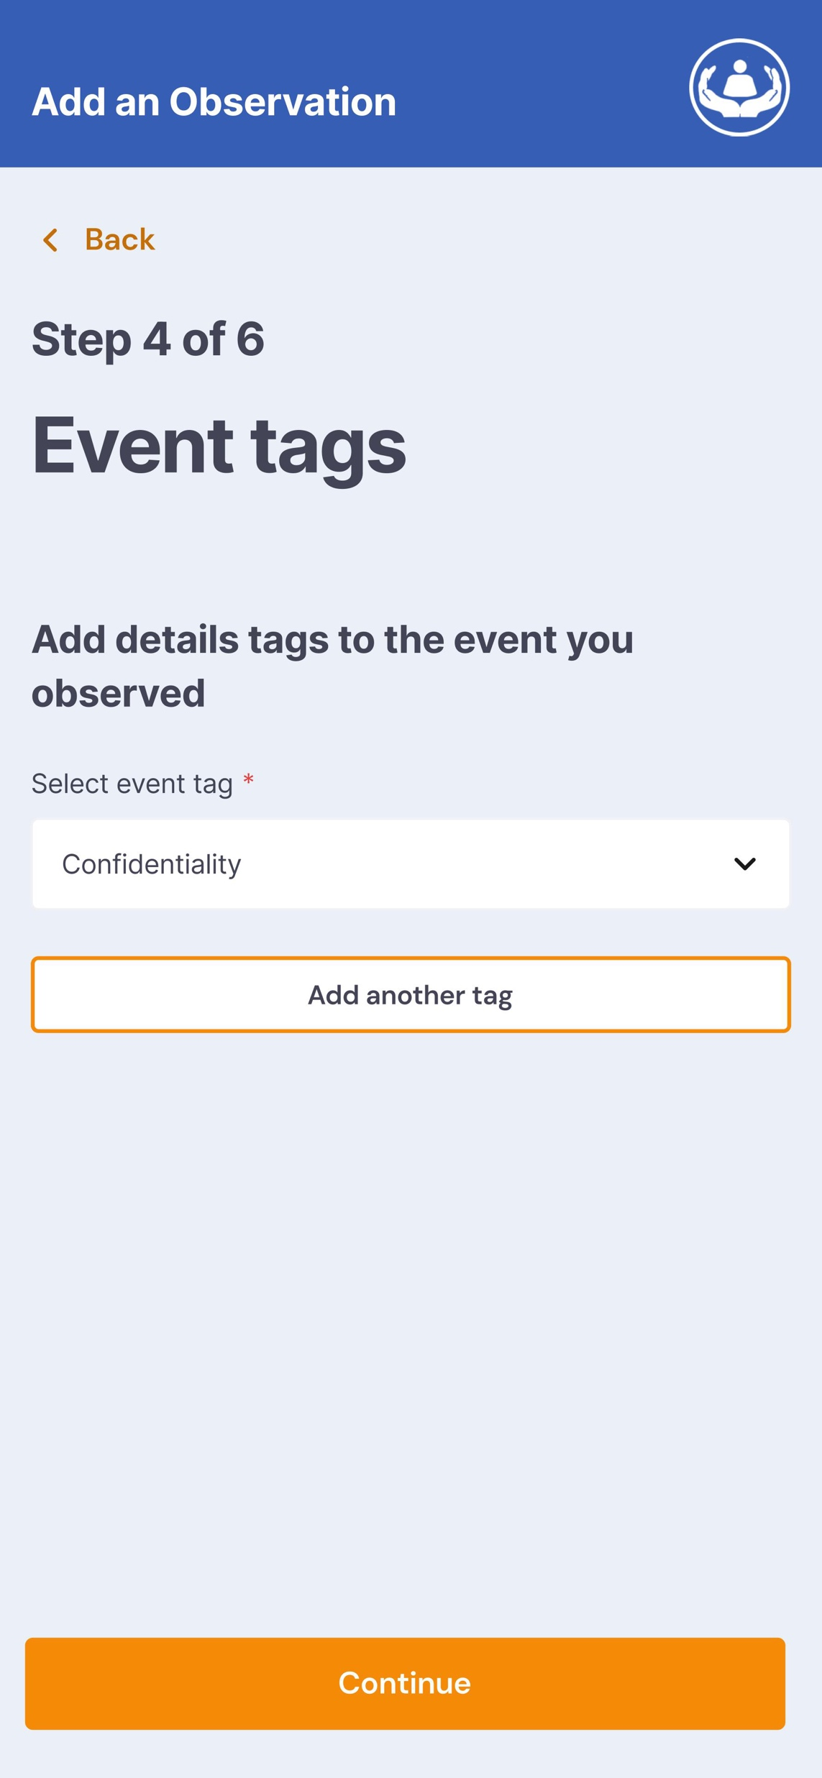
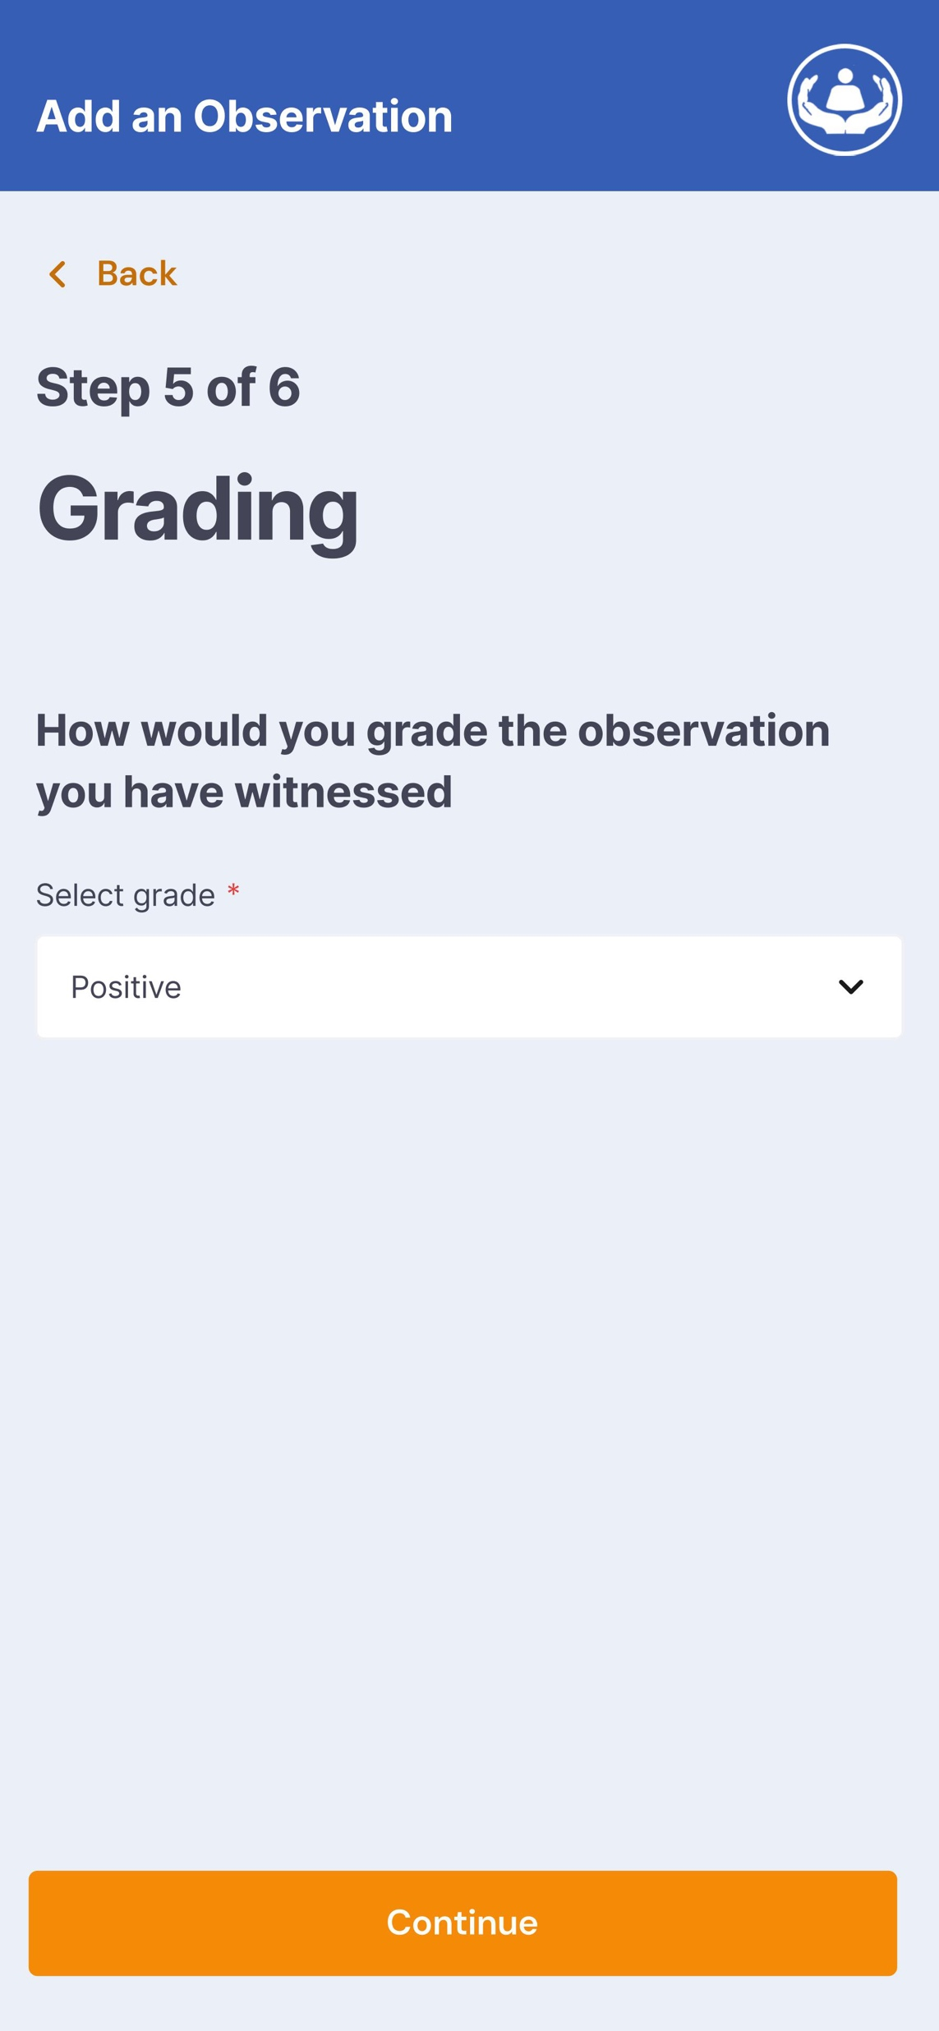
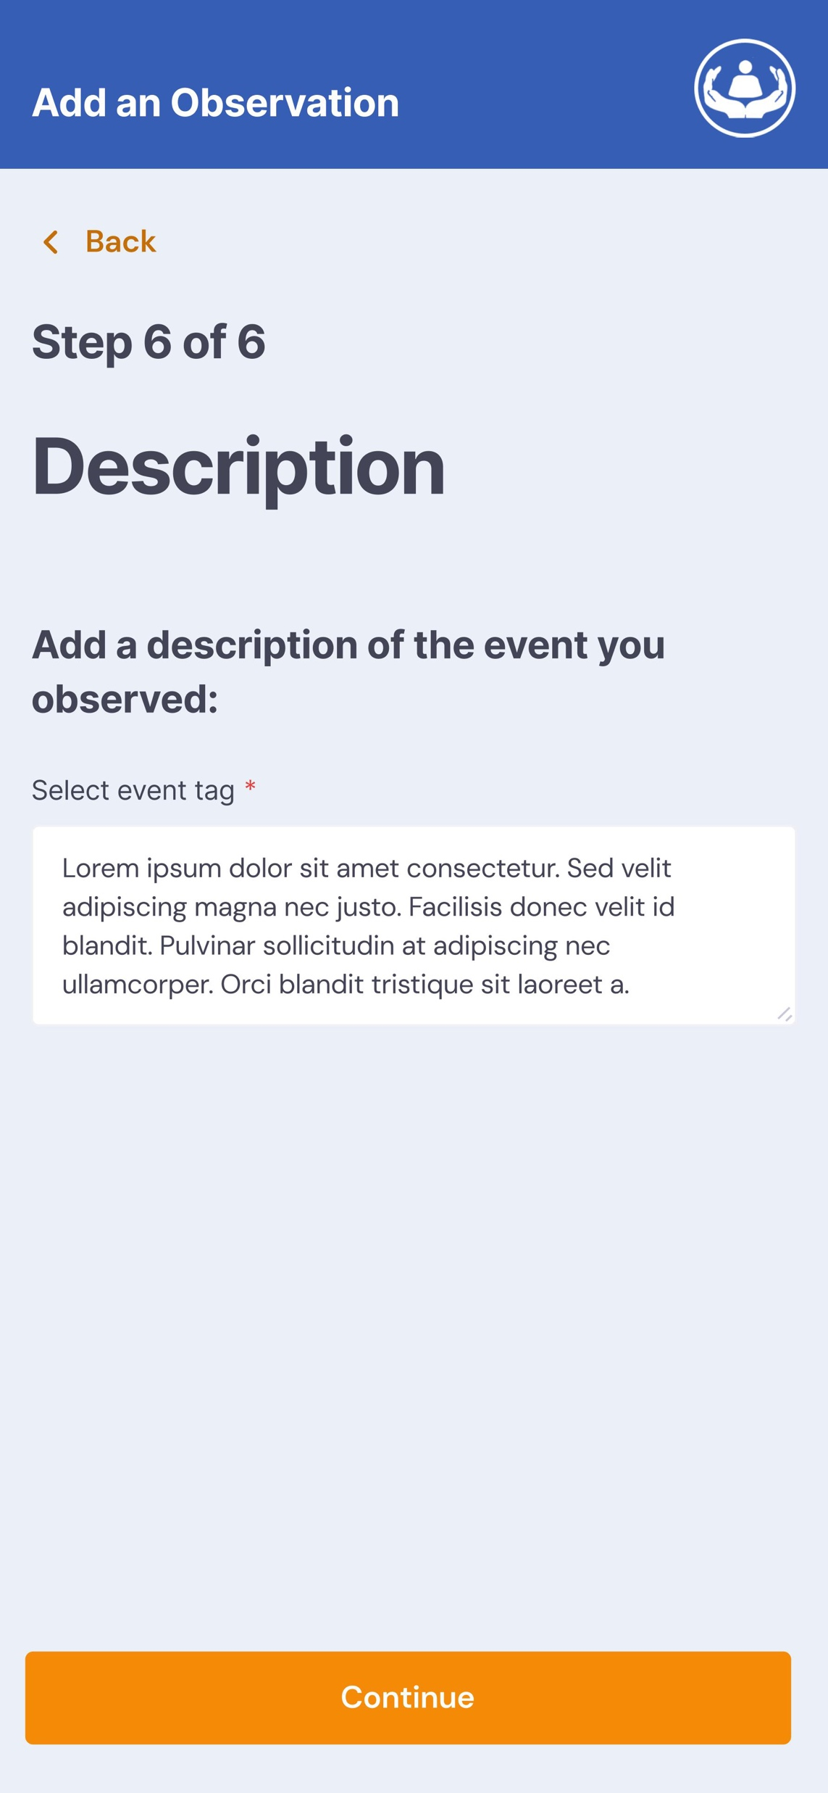
Solution:
More meaningful intelligence
More collaborative leadership, empowering staff
More learning from what went right (Safety-II)
Builds on Patient Safety Incident Response Framework (PSIRF) – 2024

Slide 4
Why HTOPS?
Real-time observations which fill in intelligence blind spots
Quick feedback from peers, constant self-improvement, safe space
Teams explore good and poor practice

Slide 5
Market Potential:
OECD: 8.7% of healthcare budgets spent on preventable harm
Annual budget | NHS England | Larger acute NHS trusts
Total | £179 billion | £1.5 billion
Spend on preventable harm | £8 billion | £67 million
PSIRF target by 2025 | Save £850 million | Save £6 million
215 NHS trusts, 124 are acute trusts

Slide 6
Business Model:
Providing the HTOPS App to NHS hospital trusts for an annual subscription

Slide 7
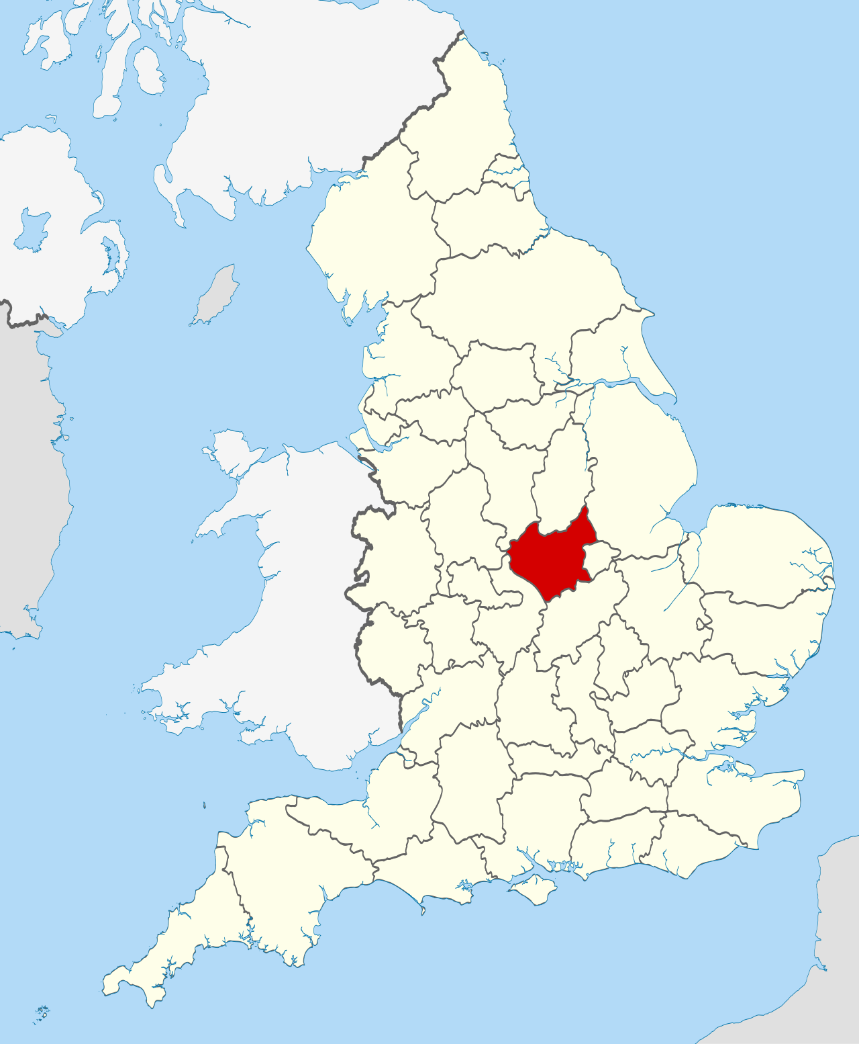
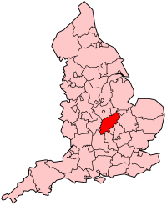
Go to Market:
Networking, events, direct outreach into NHS trusts
Acute: Leicester (UHL) Acute: Northampton/Kettering (UHN)
Non-acute: Leicestershire (LPT)

Slide 8
Competition:
 | Power BI | Datix | LFPSE | 15 Steps Challenge toolkit | HTOPS
More meaningful intelligence | ❌ | ❌ | ➕ | ➕ | ➕➕➕
More collaborative leadership | ❌ | ❌ | ➕ | ➕ | ➕➕➕
More Safety-II learning | ❌ | ❌ | ❌ | ➕ | ➕➕➕

Slide 9


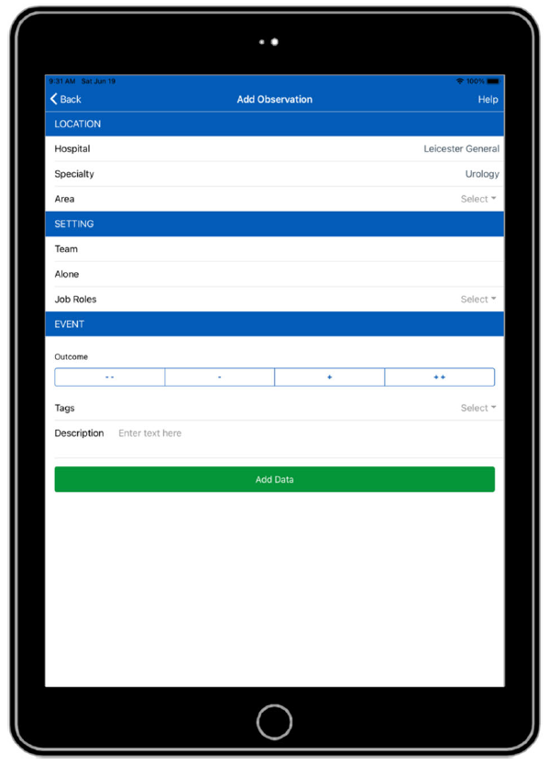

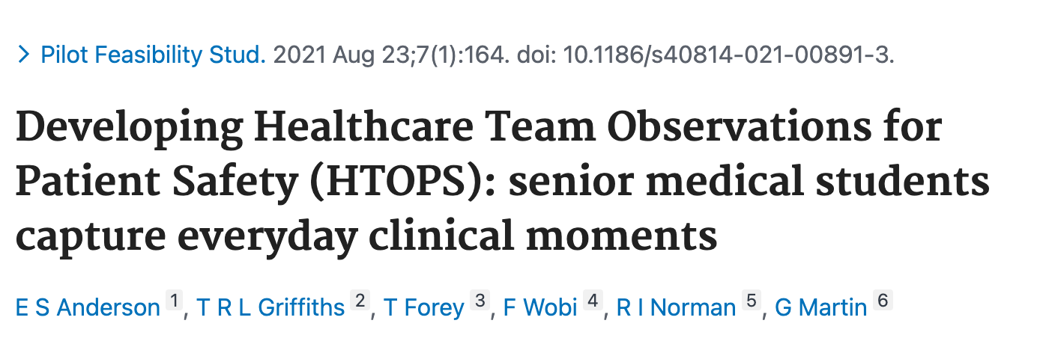
Traction:
2016-17
2018
2019
2021
2024

Slide 10
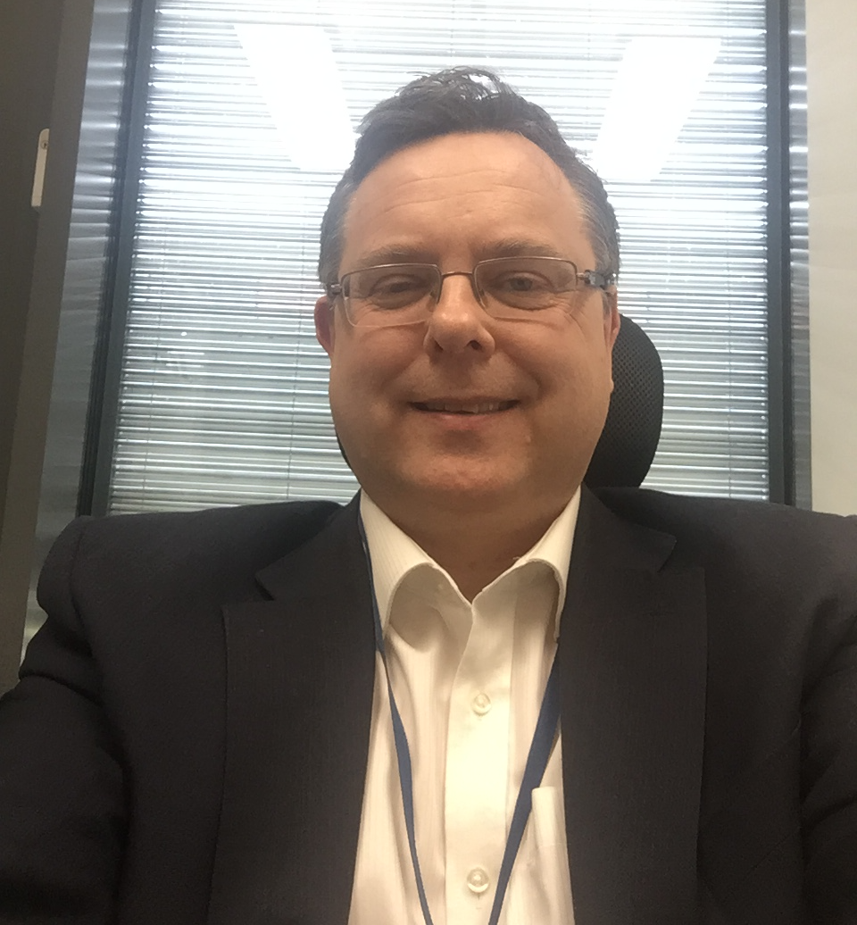
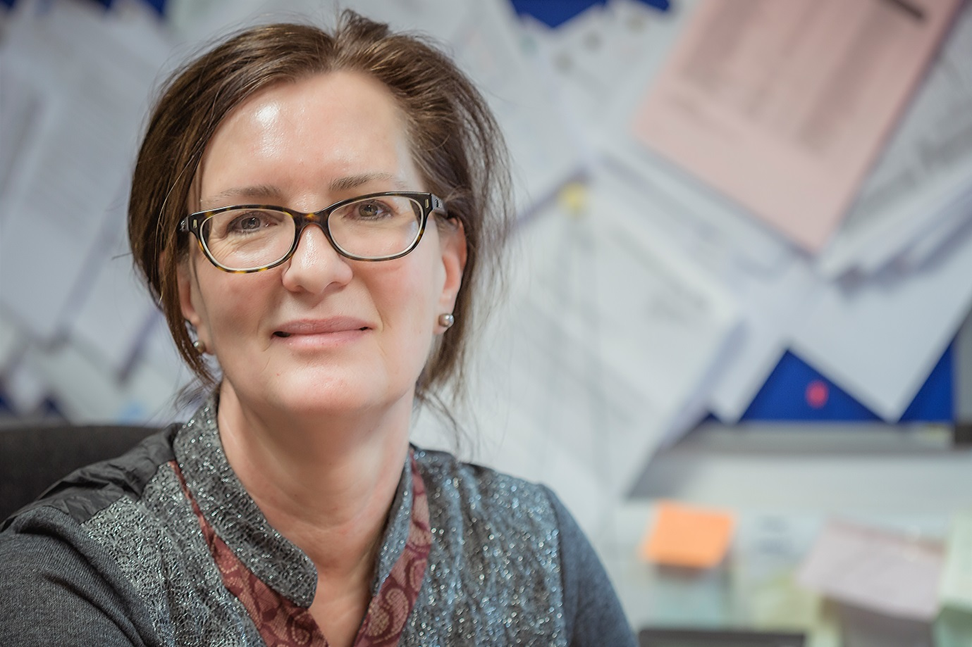

The Team:
Co-founders
Leyshon Griffiths
Liz Anderson
Non-executive Director of Leicestershire Partnership (LPT) NHS Trust
Consultant Urological Surgeon

Slide 11
The Financials:
Annual subscription per NHS trust: £20,000
Year 1: Pilot in 3 local trusts (2 acute and 1 non-acute)
Year 2: Expand to 5 acute trusts and 2 non-acute
Year 3: 20 acute trusts and 5 non-acute
Year 5: 70 acute trusts and 10 non-acute

Slide 12
The Ask:
To welcome a co-founder with £150,000 to invest
- NHS digital requirements
- Marketing

