Slide 1
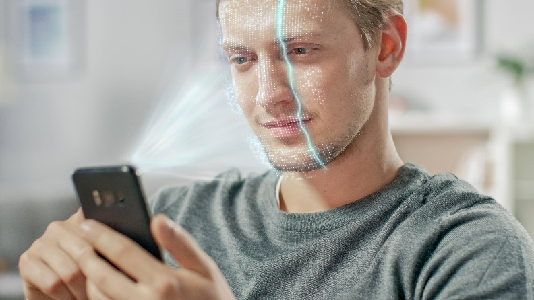
Loughborough University Concussion IDentification: LUCID
Objective and Rapid Concussion Assessment
Dr Thom Wilcockson
t.wilcockson@lboro.ac.uk

Slide 2
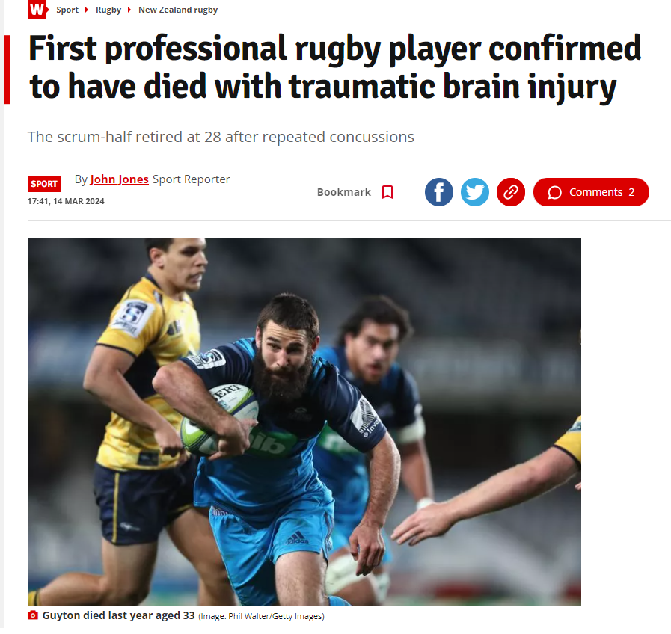

Slide 3
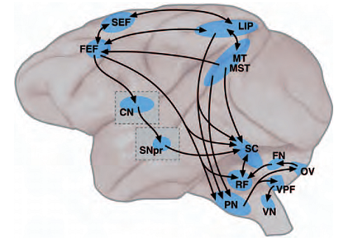
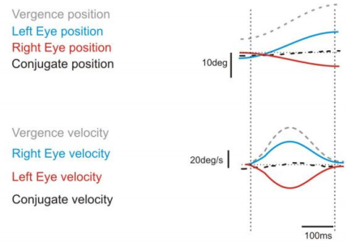
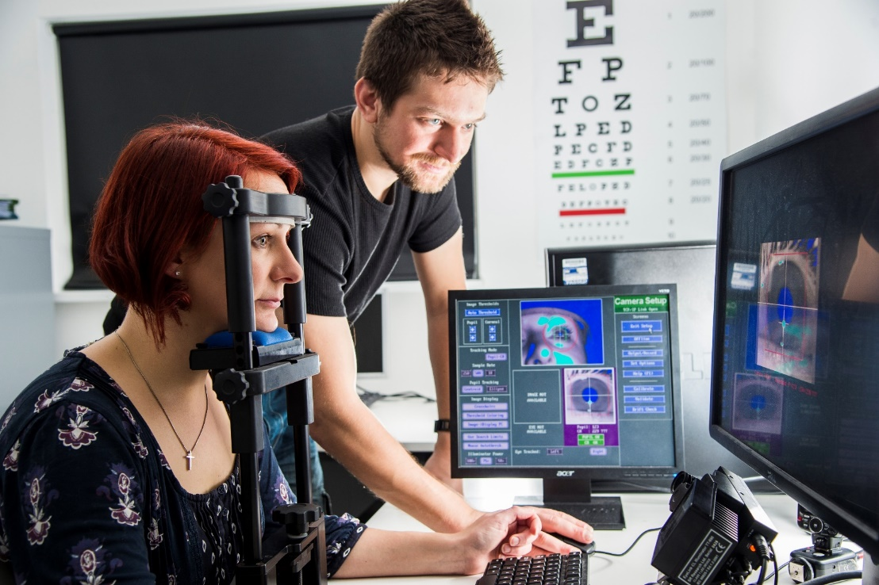
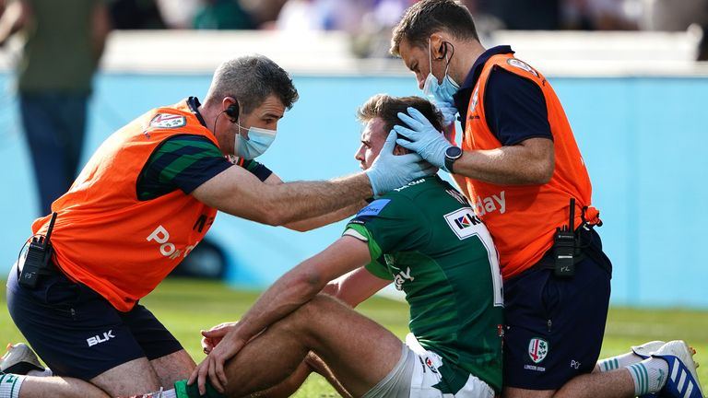
Eye movements by controlling visual attention
Scanning of the visual field and target selection
Motion sensitive region controls smooth pursuit
Regulates saccades
Retinotopic map for control of gaze
Notes:
MT and MST – calculate the velocity of the target.

Slide 4
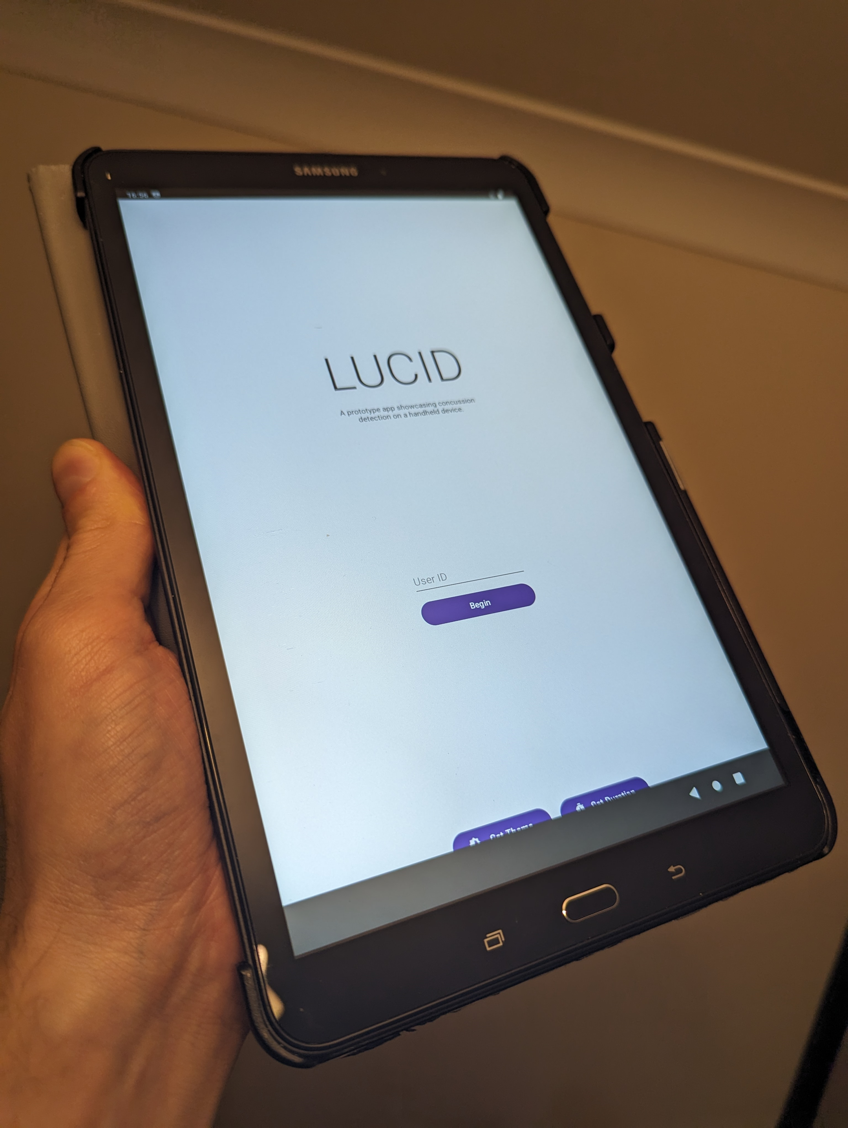
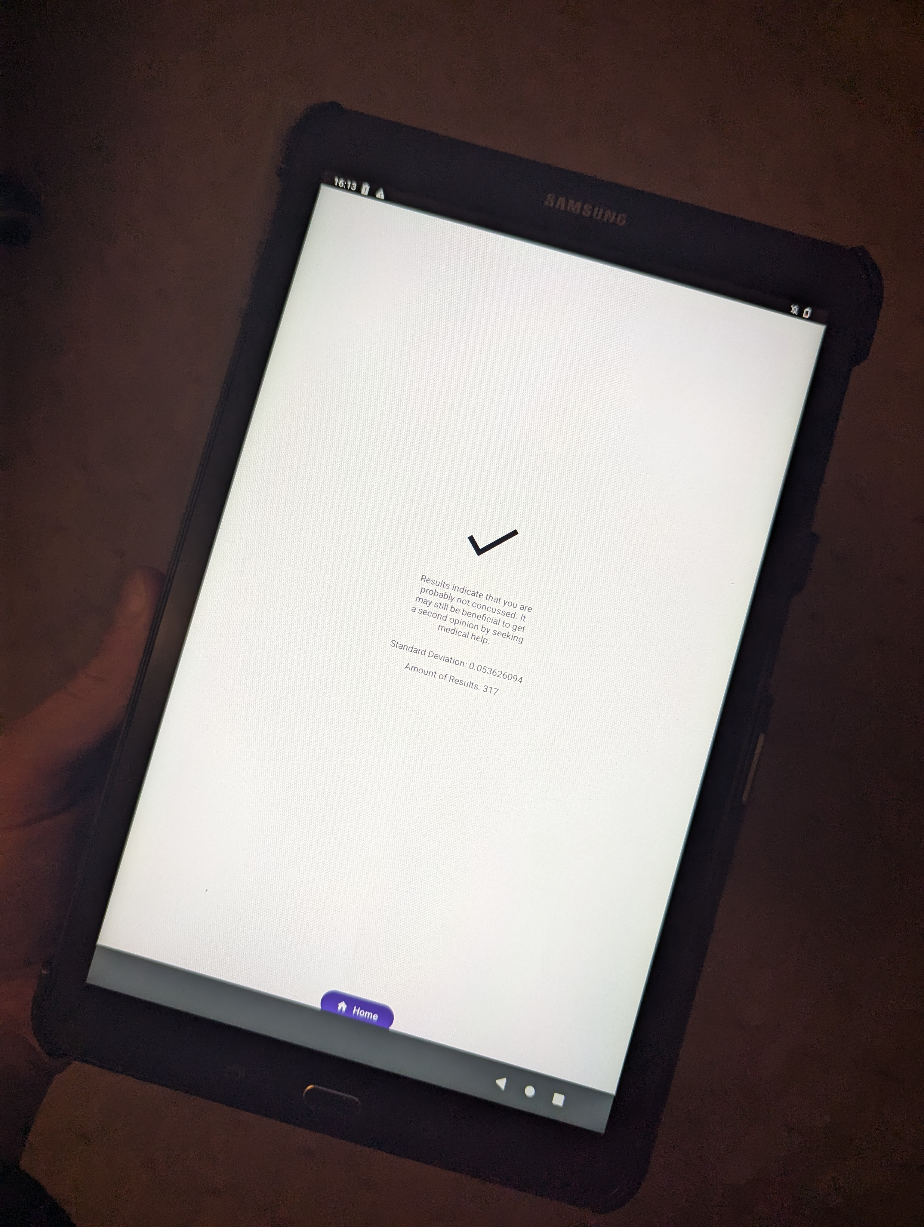
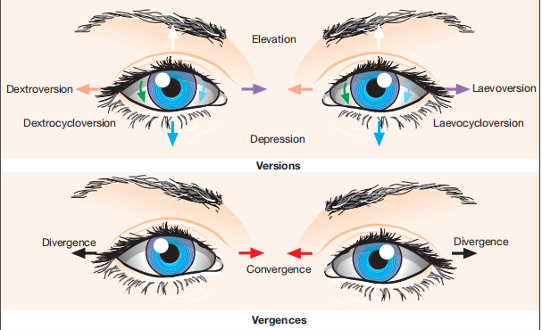
Product

Slide 5
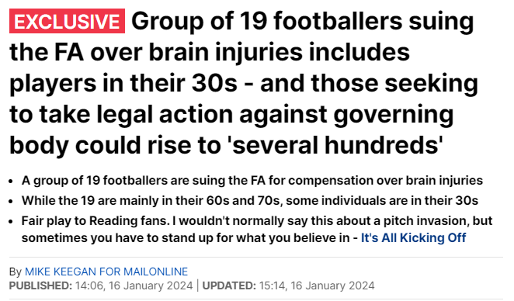
The Market

Slide 6
The Market Potential
1 million concussion in UK sport per year
1.4 million head injuries in NHS per year
3.8 million concussions in USA sport per year
Example costs: RFU (Rugby Football Union): £1.8 million spent on concussion by RFU per year
A Vast Market
Sports teams (professional and amateur)
Hospitals and clinics
Military and emergency services
Workplace safety

Slide 7
The Business Model
Licensing and subscription model
Licensing fees to sports teams, hospitals, and clinics.
Subscription model for data analytics and remote monitoring.
Licenses: Sport governing bodies NHS Trusts
£50,000 per body per season £10,000 per trust
(approx. 200 in UK) (over 120 NHS Trusts)
Note, we are already in talks with interested parties in sports and the NHS

Slide 8
Competitive Advantage
 | SCATs (current practice) | Saliva | Blood | Biosensors | VR | LUCID
Pitchside
Objective
Accurate
Cost
Ease
Availabilty for all
Ready for use |  |  |  |  | Pilot tests | SOON!

Slide 9
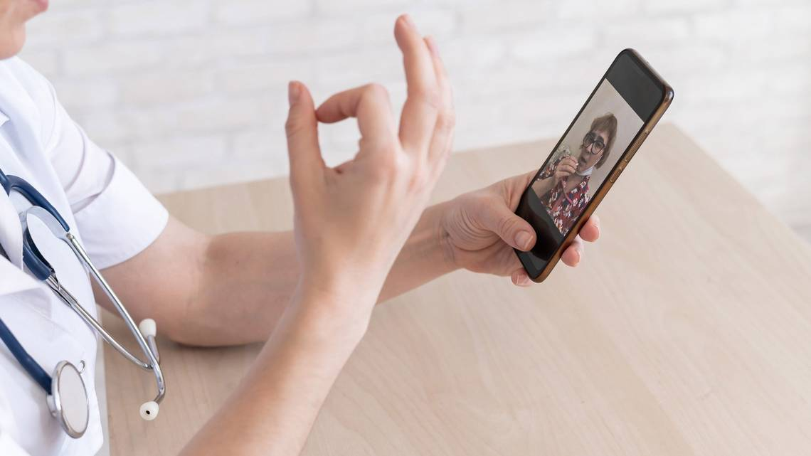
Traction

Slide 10
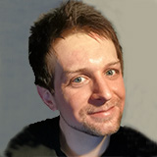
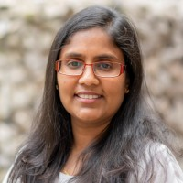
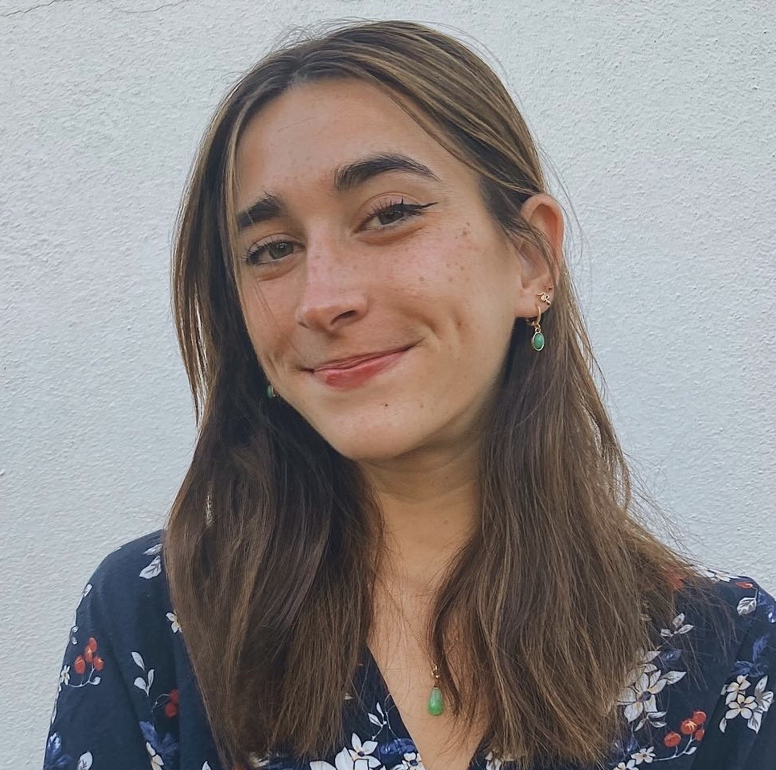
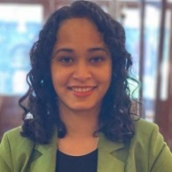
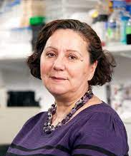
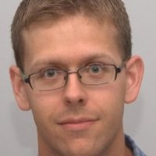
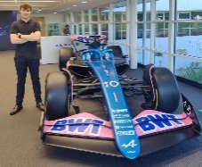
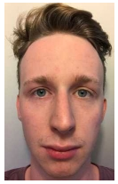
Team LUCID
Loughborough
University
NHS
Regulatory
Thom:
Founder
Monalie:
TTO
Kim:
Market
Research
Sankanika:
Neurologist
Elizabeta:
Psychiatrist
Bryan:
Regulatory
Consultant
Dave:
Patent Attorney
Oli:
Programmer
James:
Programmer

Slide 11
Finances: Market potential
Year | License targets | Sales/Income
Present | Secure investors/grants
Year 1 | Two sports bodies (including RFU) | 2 customers: £100,000
Year 2 | Additional sport bodies in UK and first NHS Trusts (120 NHS Trusts available) | 5 additional customers: £320,000
Year 3 | Overseas targets (e.g. NFL) | 10 additional customers: £740,000
Notes:
$20,000
Millions each
CT scans alone are expensive.

Slide 12
Next steps…
Ongoing work:
Complete clinical validation and regulatory approvals (CE in Europe, FDA in US).
Completed in coming months (early analyses indicate no risk of failure)
This step is needed for sports team adoption
Funding request:
We need investment of £250,000
£100k: Clinical trials (needed for NHS adoption: note, distinct from clinical validation)
£75k: Staffing for IT support and app improvement.
£25k: Real-time support services.
£50k: Data protection & cybersecurity measures (due to handling personal medical data).

Slide 13
Loughborough University Concussion IDentification: LUCID
Objective and Rapid Concussion Assessment
Dr Thom Wilcockson
t.wilcockson@lboro.ac.uk

