Slide 1



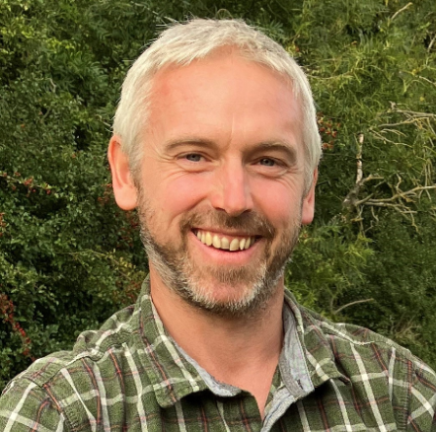

Aspis
Making wound care
stick
Dr Chris Young
Molecular medicine
Partner, co-inventor
Email: chris.young@dmu.ac.uk
Mobile: +44 7492079124

Slide 2

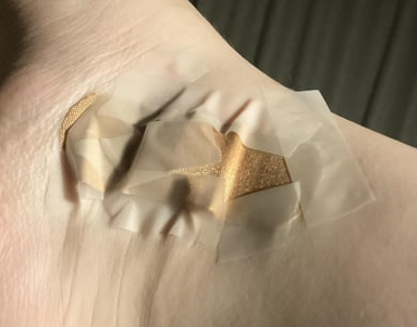
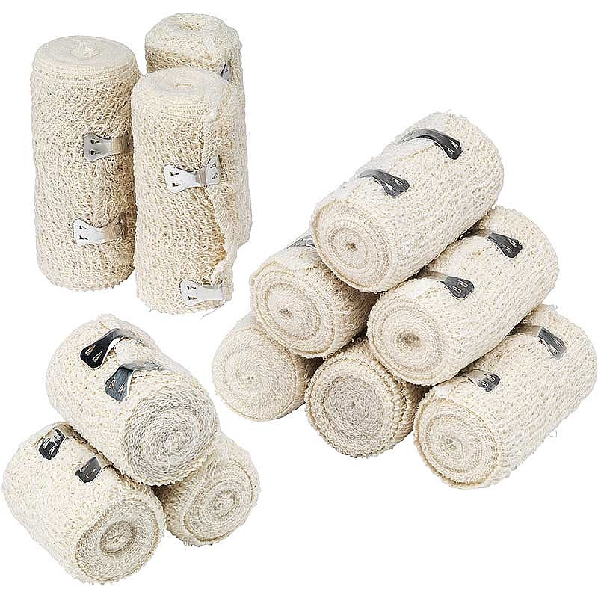
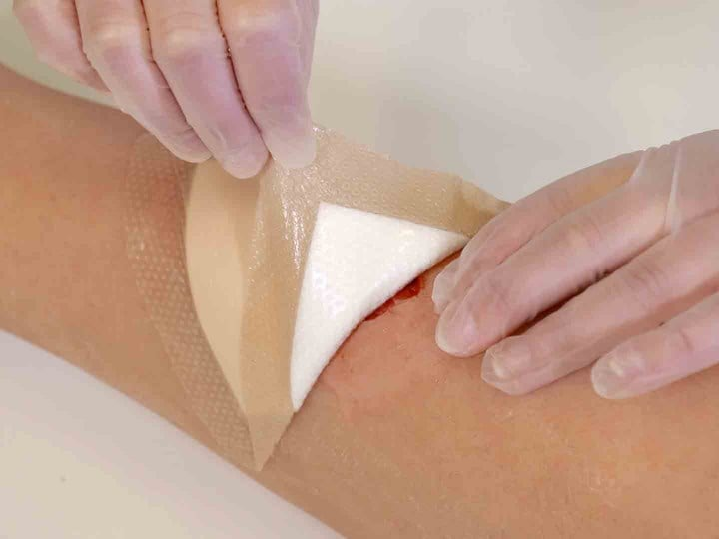
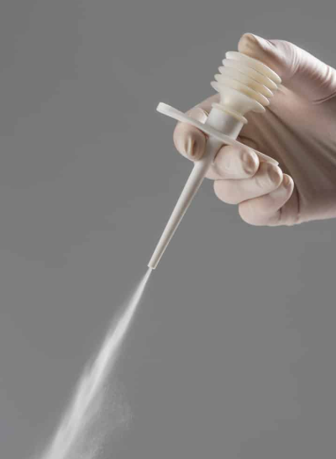
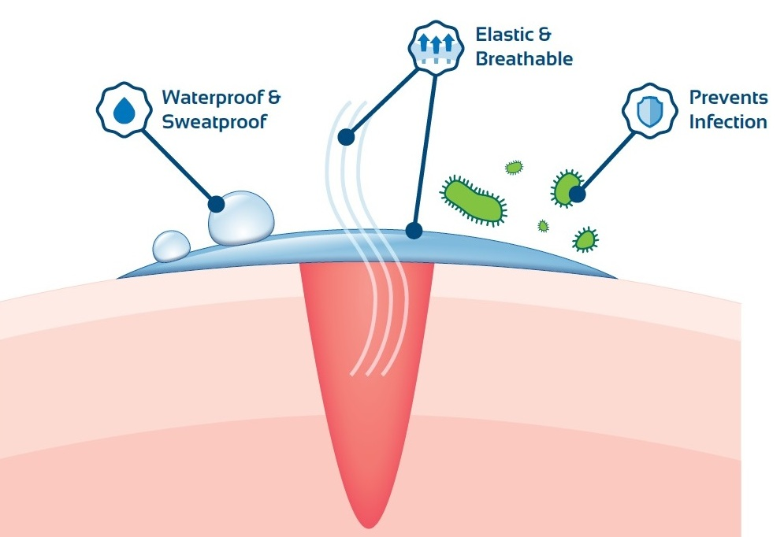

Market Problem:
Solution:
Antibacterial
Antifungal
Aspis

Slide 3


Competition
Wet-adhesive
Waterproof
Antibacterial/
antifungal
Haemostatic
Bioabsorbable
Non-toxic
Cheapest material
No
No
No
Aspis
No
USP
USP
USP

Slide 4

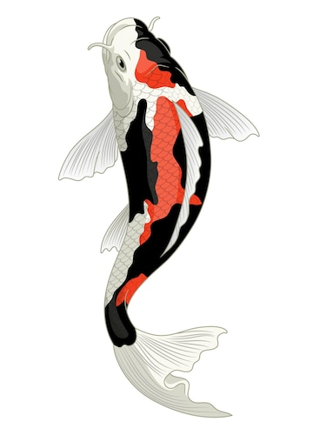





Business Model(s)
EU distribution
Wholesalers/distributors
Spin out from DMU:
Aspis
Wholesalers/distributors
US & EU distribution
Spin out from DMU
or Licensing:

Slide 5
Market size(s)
Fish care = est. £48 million
Combat dressing market size = est. £0.8 billion
Veterinary wound dressing market size = est. £1 billion
Burns dressings market size = est. £2 billion
All set to rise ~5% over next 5 years
(Grand View Research, 2024)

Slide 6
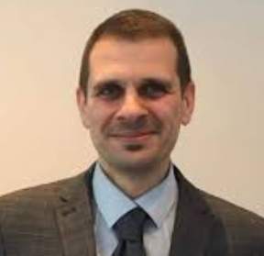
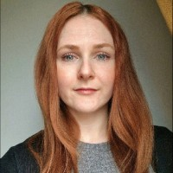

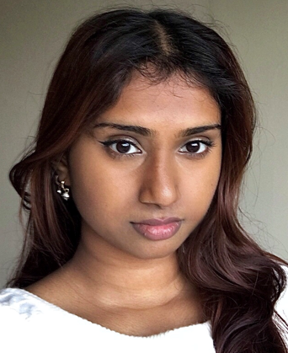

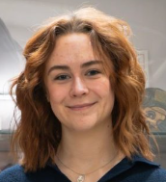
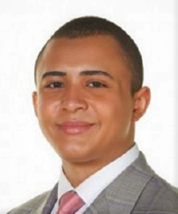

The team
Dr Chris Young
Molecular medicine
In vitro and in vivo
modelling
Dr Omar Qutachi
Medicinal products
Materials & formulation scientist
Dr Jess Locker
Microbiologist
Wound healing expertise
Dr Abu-Bakr Abu-Median Veterinarian &
Veterinary
microbiologist
Harini
Satkunarasa
1YR Placement
student
Lead:
Commercial, R&D
product development,
experimental modelling
Co-inventor
& partner
Lead:
Materials chemistry, formulations, pharmaceutics
Co-inventor
& partner
Lead:
Pathology &
infection modelling
Lead:
Animal models
Lead:
Wet lab R&D & QC
Divine Derefaka PhD Student
Eleanor Makin 1YR Placement
Kyle Gordon PhD student
Michal Kozielecki PhD student

Slide 7

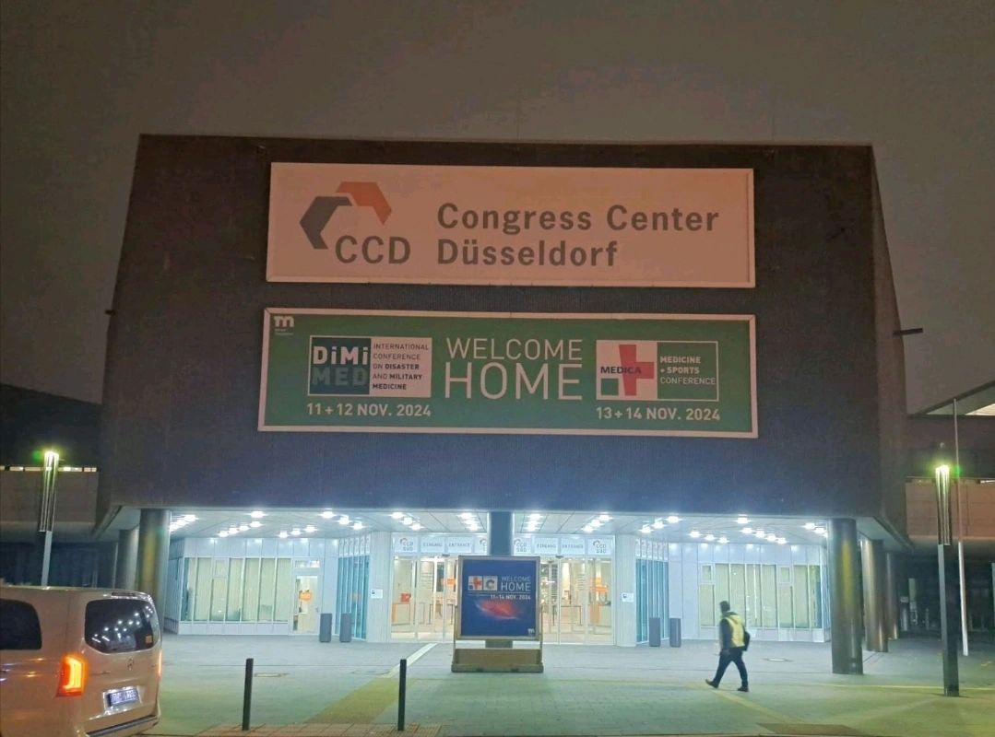
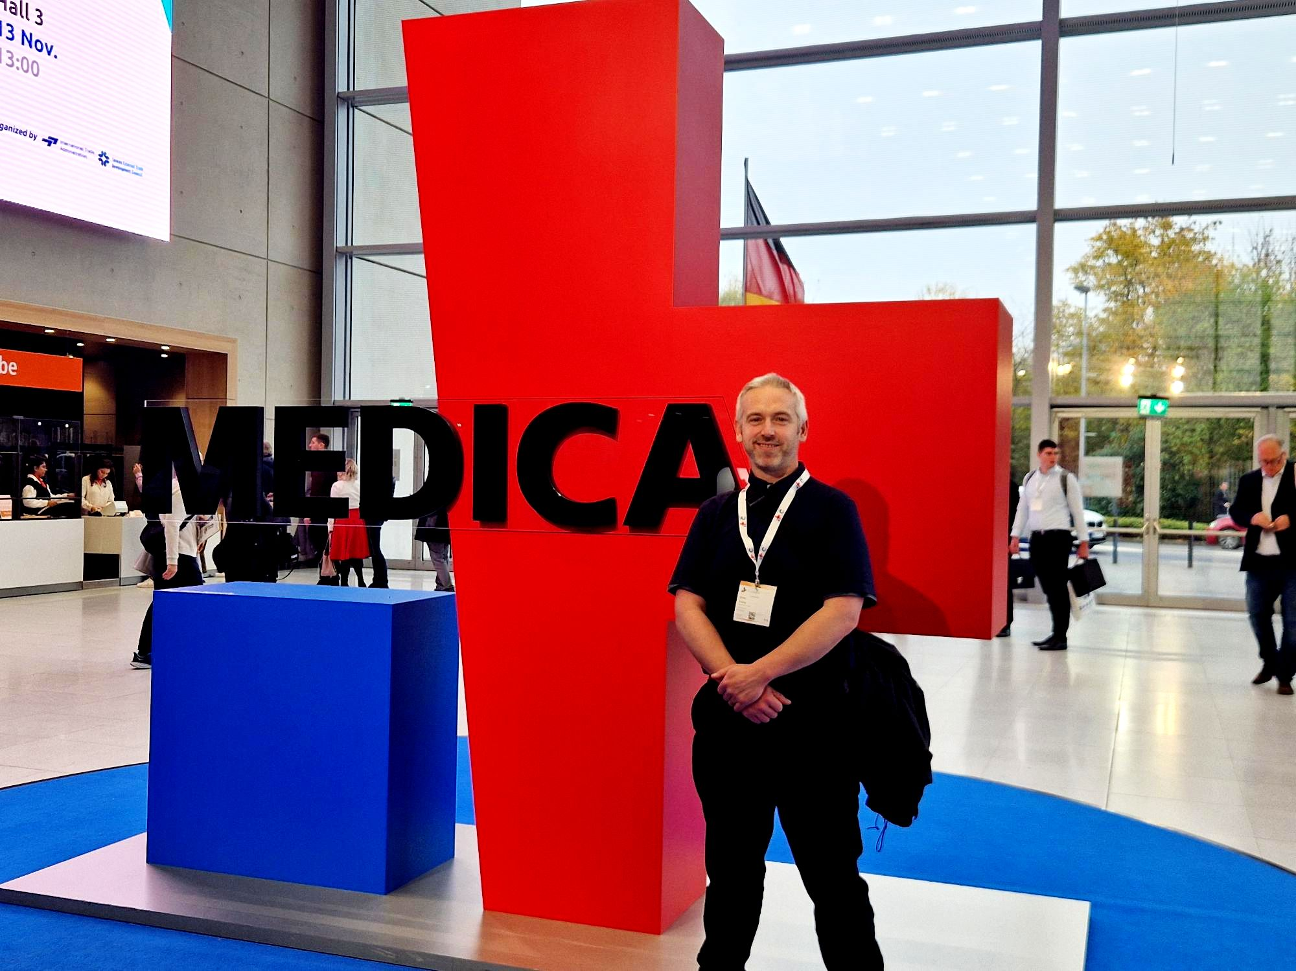
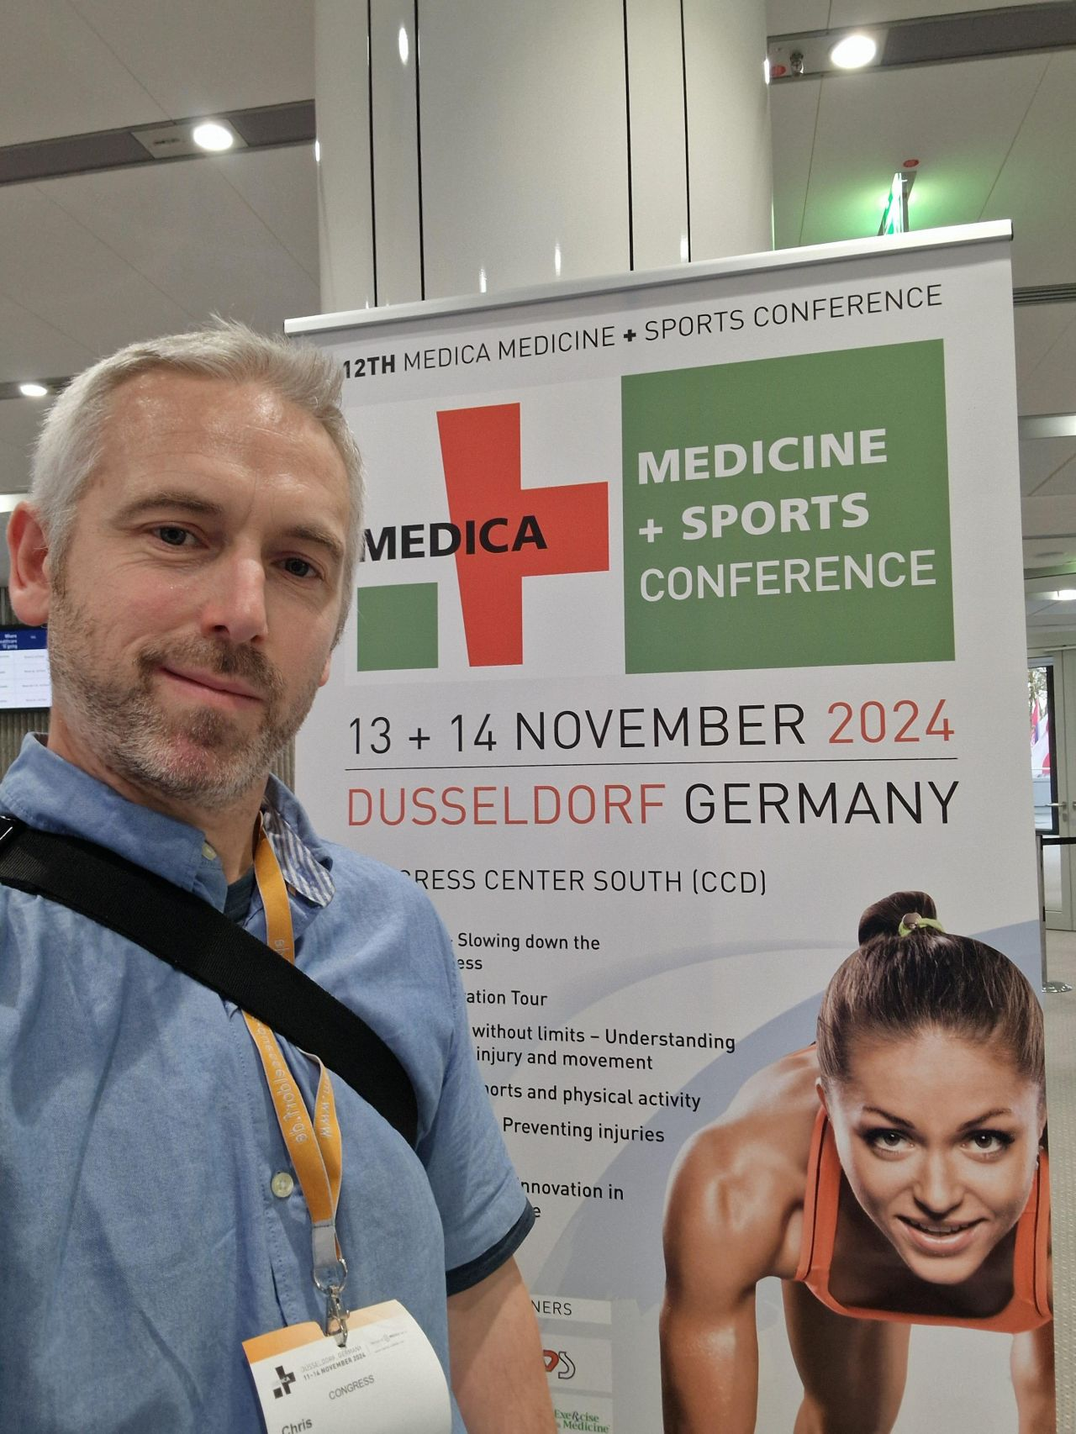
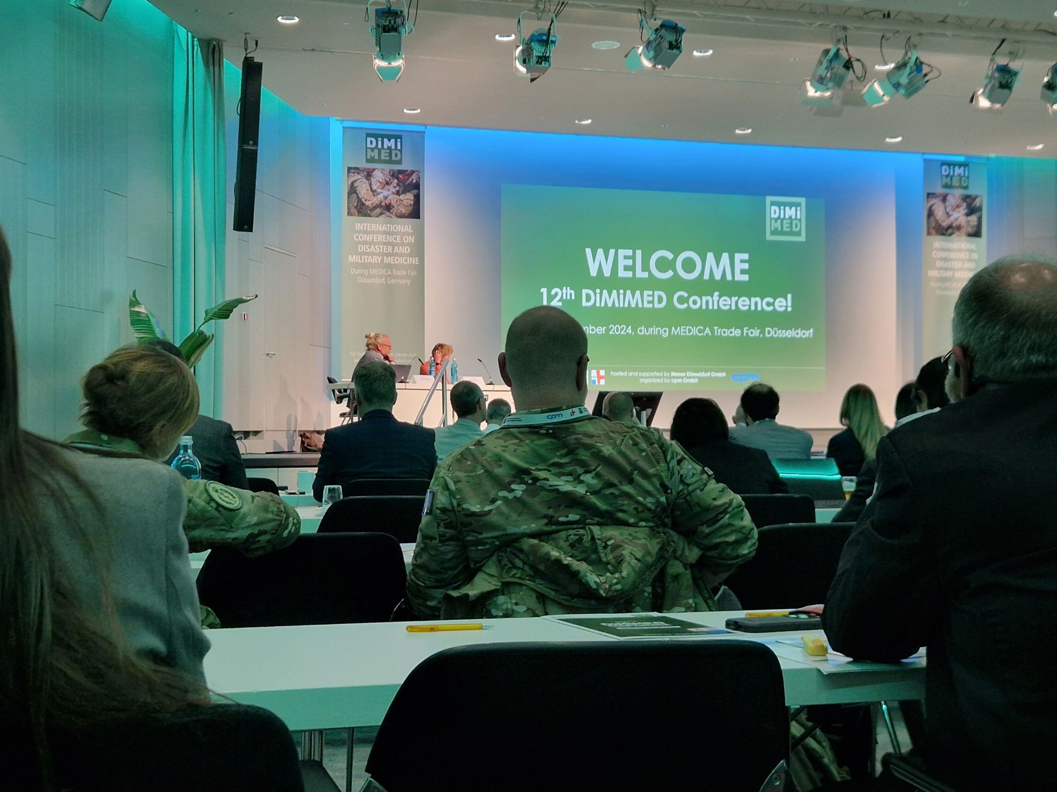
Traction

Slide 8
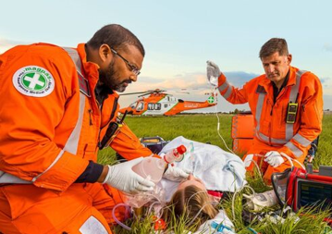



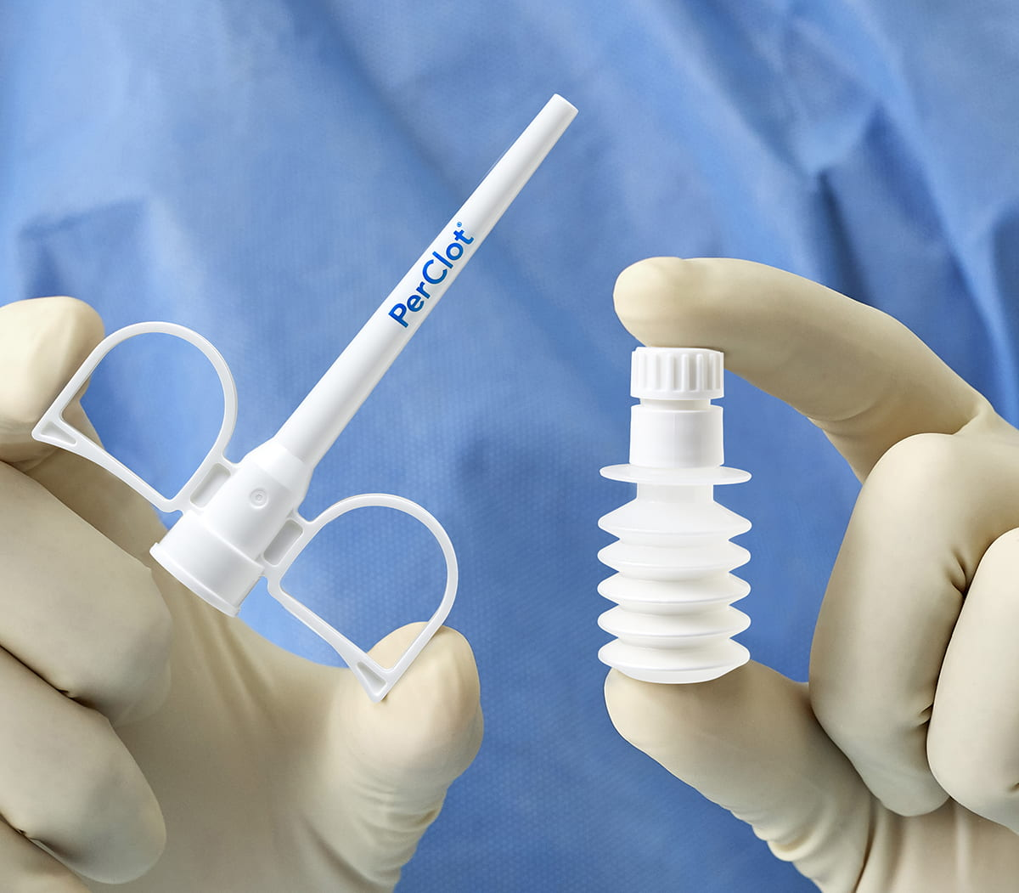
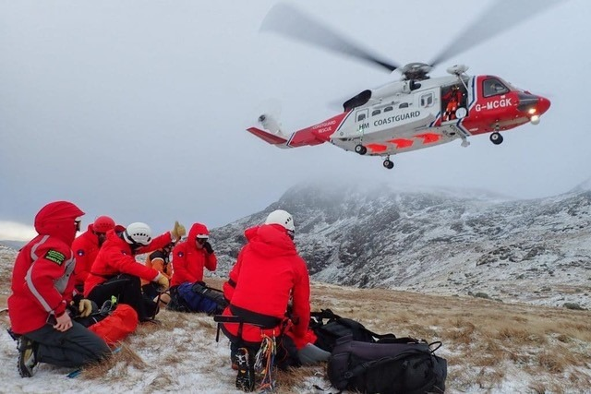
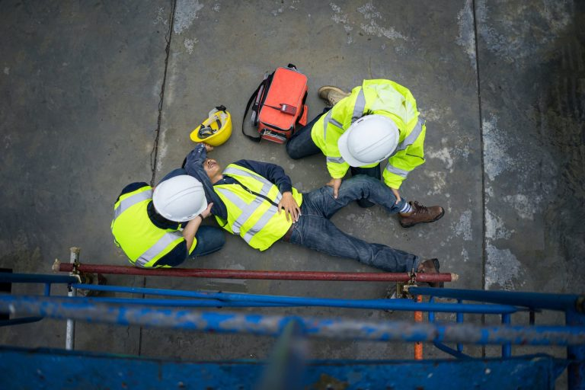
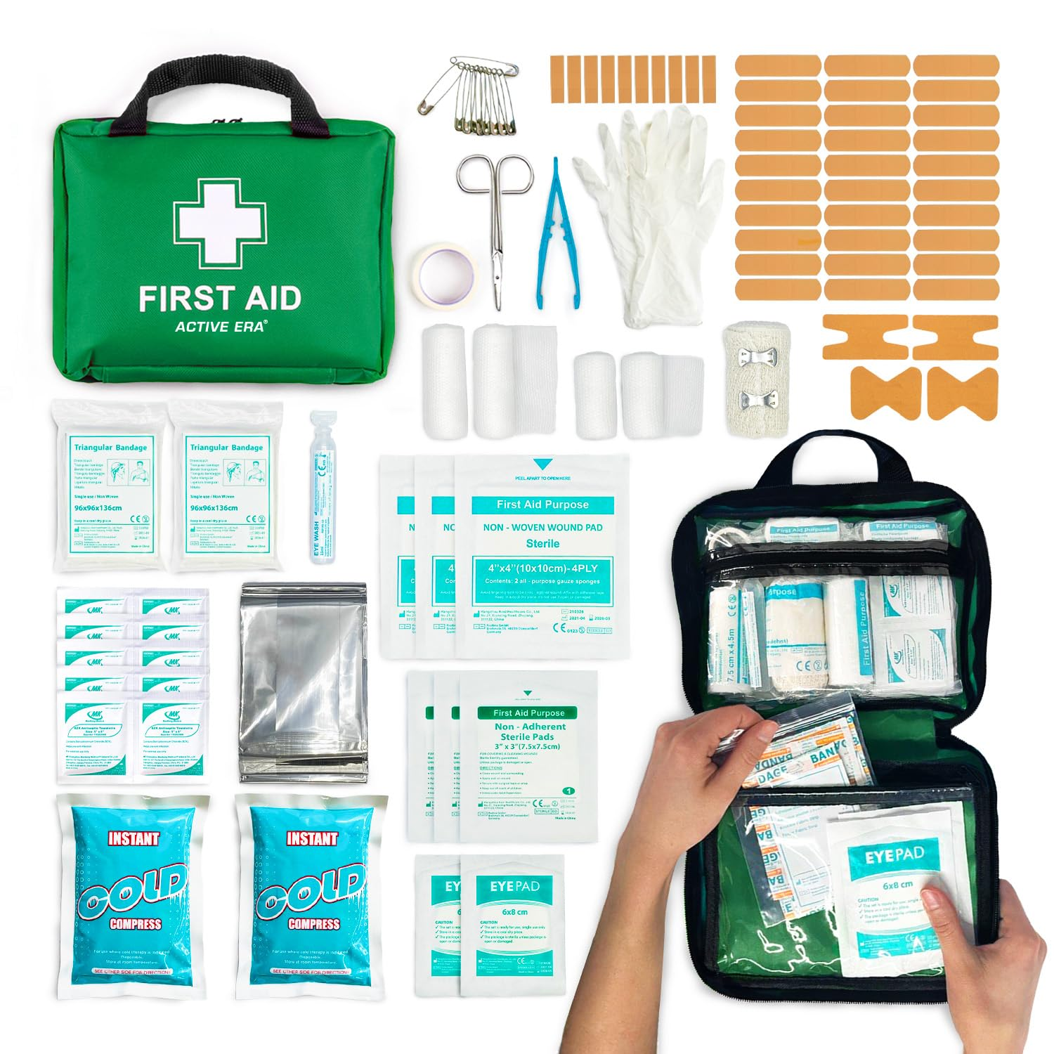
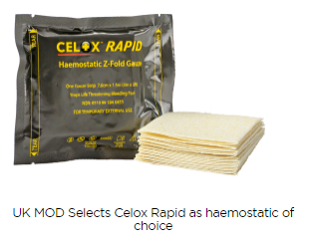
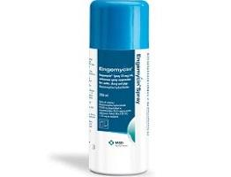
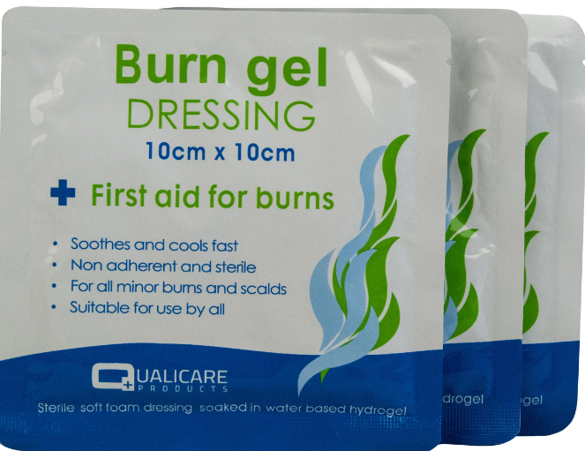
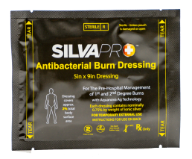
Why invest now?
Aspis
Portfolio of industry informed products over next 5 years
Veterinary wound care
Haemostatics
Burns

Slide 9




Potential exits:

Slide 10
Predicted growth
(fish)
Period | Sales (units) | Net Profit, Aspis (£) | Model | Net profit, 12 lines (£)
Year 1: 2025 | 25K | £50K | Beachhead in UK | £50K
Year 2: 2026 | 100K | £200K | Marketing to increase market share + 2 new product lines | £300K
Year 3: 2027 | 250K | £500K | Expansion in Europe + 2 new product lines | £1 Million
Year 4: 2028 | 500K | £1 Million | Commence domination of UK and EU markets + 3 new product lines | £2.5 Million
Year 5: 2029 | 1 Million | £2 Million | Establish beachheads in US & Asia + 4 new product lines = 12 in UK and EU | £5.45 Million

Slide 11
The ask:
R&D for vet/human markets
Admin + marketing
Spin out production facility
Outcome | Rationale | Cost
Manufacturing suite; scale-up Aspis production to spin out | Equipment: Milling Automated bottling & labelling QC Cold Storage Bulk chemicals | £3,000 £40,000 £3,000 £5,000 £2,000
Move to veterinary & human application | Labour: Production Manager, 0.5 FTE, 2yrs R&D & animal work up | £40,000 £160,000
Administration | Bookkeeper/Accountant: 5 years | £5,000
Marketing | Website and branding | £10,000
 | Total: | £268,000
£53k
£200k
£15k
Now
Oct
2025
Oct
2026
Admin 1.9%
Marketing 3.7%
Equipment 19.8%
Labour 74.6%

Slide 12
Aspis
Making wound care
stick
Dr Chris Young
Molecular medicine
Partner, co-inventor
Email: chris.young@dmu.ac.uk
Mobile: +44 7492079124

