Slide 1
Individual Assessment Feedback (INDAF)
An App that creates automated individualised assessment feedback.
Sold to education providers as a Web application.
Christof Leicht, c.a.leicht@lboro.ac.uk
Loughborough University

Slide 2
Problem
Tuition fees as a share of higher education income in the UK
Students often do not get any exam feedback
Why? The traditional approach is labour-intense
→ Students are dissatisfied
→ Lower University ranking/esteem
→ Lower University income
Source statista.com; HESA, ID 376075
Source officeforstudents.org.uk

Slide 3
Solution
Automation of assessment report provision using existing marking data
→ Minimising staff workload
→ Providing individualised, student-centric feedback

Slide 4
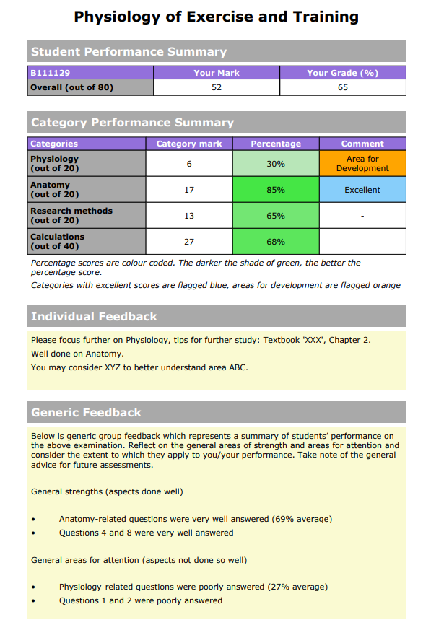
Product
Existing MVP
Windows Application
Provides marking environment
Creates individual feedback reports
VentureVersity
Web App high-fidelity prototype

Slide 5
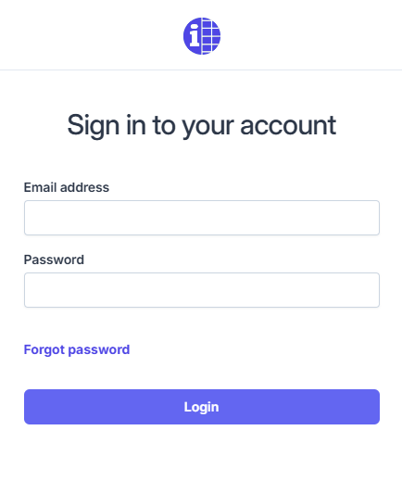
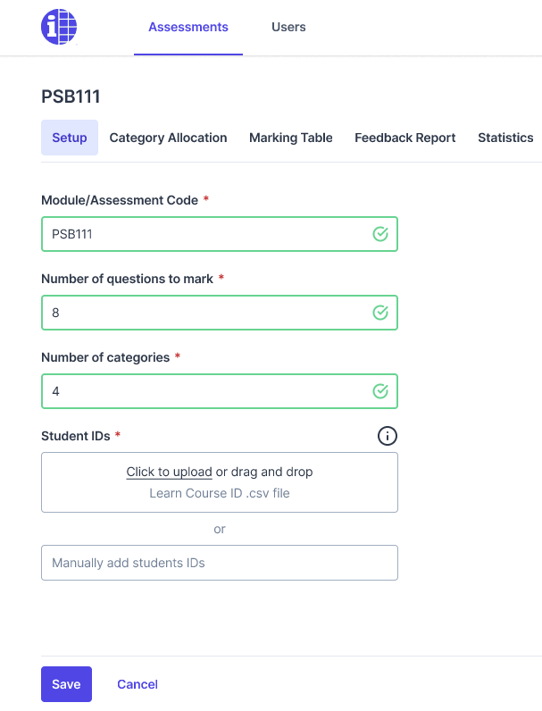
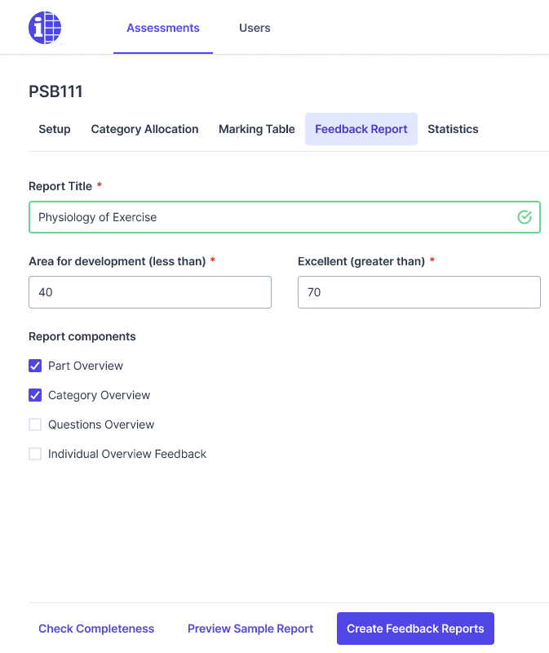
VentureVersity:
- High-fidelity prototype development - Customer discovery

Slide 6
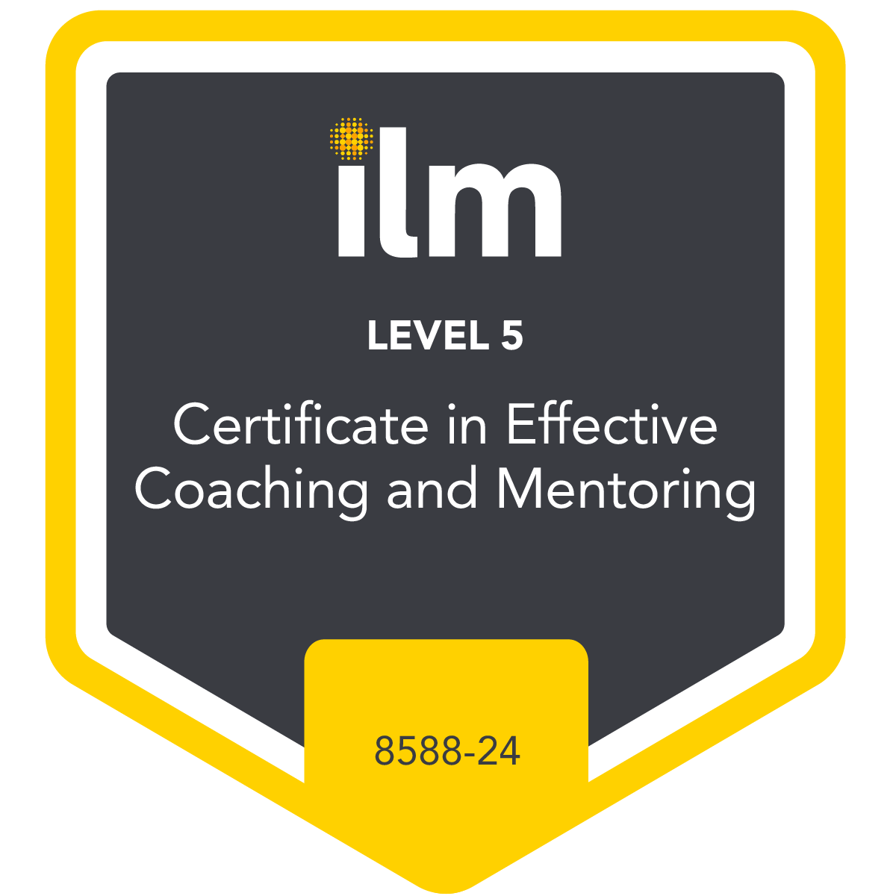
Go to market
‘Large cohort’ institutions
Medical education (Germany)
Professional certification providers
Exam focus & large cohorts
30% of 10k English speaking Unis
£30M/year (SOM)
£10k subscription

Slide 7
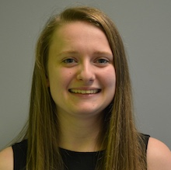
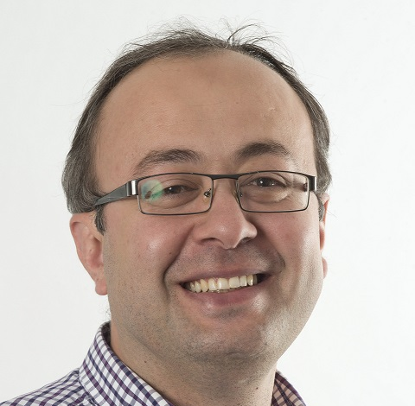
The team
Inventor
Christof Leicht
Web access / user admin development
Rebecca Dickinson, Swipe & Tap
IP commerciali-sation
Monalie Bandulasena (Lboro)
Software developer, Web App
Aaron Wardle,
Swipe & Tap
Exam / feedback consultancy
Firat Batmaz, School of Science (Lboro)
Software developer, existing Windows App
Nik Chauhan (Lboro student)

Slide 8
Competition, Caveats
Integration |  |  |  |  | 
Price |  |  |  | 
Adaptability |  |  |  | 
AI capabilities |  |  |  | 
Automated individua-lised feedback |  | Limited capa-bilities | Limited capa-bilities | 
Others
Competition
Marking software
Learning management system Plugins
Current financial climate
Strained university finances

Slide 9
Traction
Staff Y: For me, the process was not difficult and didn’t take up much extra time.
Student X: I thought the feedback system was brilliant and really appreciate knowing where my weaknesses lie
Fully developed prototype (4 rounds of Beta testing)
Rolled out across Loughborough University
App continuously shaped and assessed
Positive Student feedback
Staff feedback informing development

Slide 10
Finances
Applying for £120k in pump priming
Year | Income | Software development, adjustments and maintenance Marketing, Sales | Profit
Year 1 | £120k Pump priming | £80k (initial App development) £40k (Sales, Marketing) | £0
Year 2 | £200k 20 customers | £80k | £120k
Year 3 | £600k 60 customers | £240k | £360k
Year 4 | £1.8M 180 customers | £0.7M | £1.1M
Income per customer modelled on ‘£1 per student’ institution subscription

