Slide 1
NEST
Neuro Education Solutions Training
The first online assessment tool to audit educators’ awareness of dyscalculia
A.E.Roulstone@lboro.ac.uk

Slide 2


The Problem
1 in 20
Developmental dyscalculia is specific learning difficulty in mathematics
Only 5% of educators in the UK receive training about dyscalculia
Low numeracy skills costs the UK economy £25 billion a year

Slide 3
The Solution
Improve Knowledge & skills
Empower educators by strengthening their understanding of dyscalculia
Earlier identification & support
Better outcomes in Maths

Slide 4


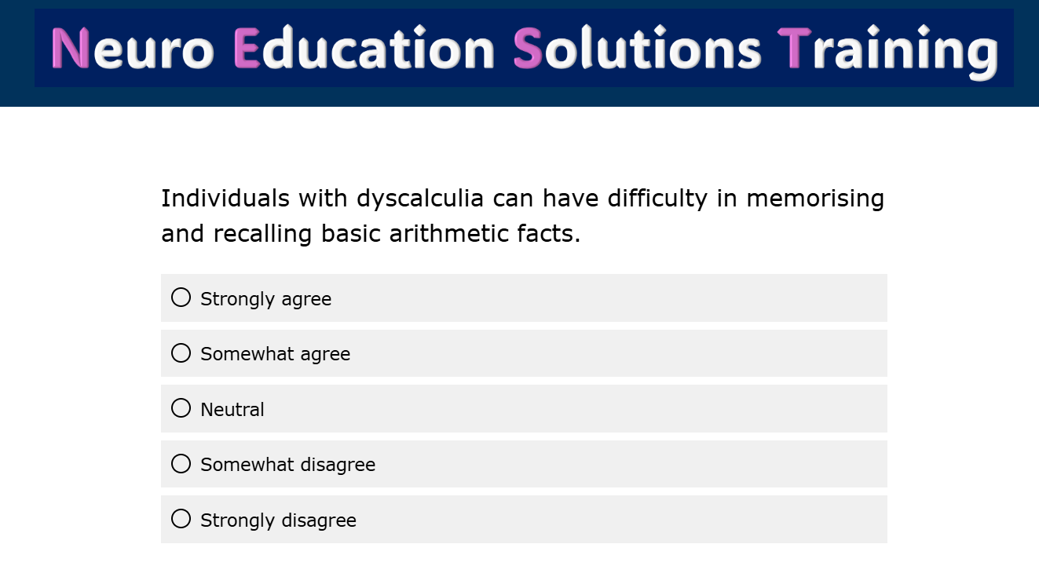
Our Product
Dyscalculia Audit Tool
Personalised Online Training
24

Slide 5
Market Potential
TAM
Total Addressable Market
£3.6 trillion
Global education training market is valued at £3.6 trillion
US education training market is valued around £8 billion annually
SOM = £2 million
TOM
Total Obtainable Market
Up to £8 billion
SOM
Serviceable Obtainable Market
£2 million*
*All figures highly informed estimates based on data from global market reports

Slide 6
The Business Model
Online platform - subscription model – access on demand content
Audit Tool
24 Statements
_________________________
JOIN FREE
To download/view
Training
Personalised training package and accreditation
_________________________
Single User
£25/year
*will be subscription based
CPD Training
Achieve whole school excellence _________________________
School & Organisations
£150/year
*will be subscription based per organisation

Slide 7



Competitive Advantage
Evidence based
Cost-effective
Quick - Less than 10 minutes to complete the audit
High quality
Individualised training packages
Access any time resources

Slide 8

Our Progress
Audit tool was tested with over 1200 educators in the UK, Italy, Vietnam & South Africa
NEST
Audit tool validated by 30 experts in dyscalculia research
Conducted extensive market research in the UK

Slide 9
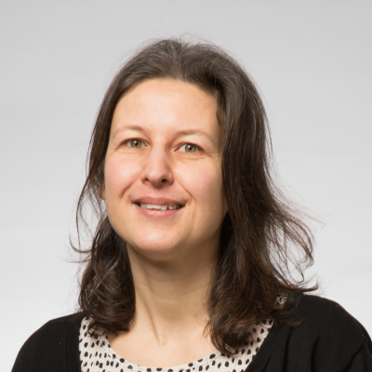
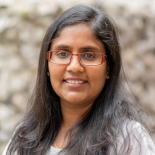
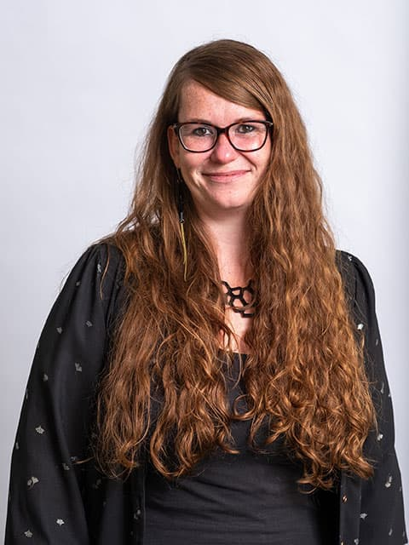
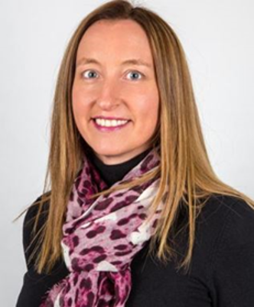

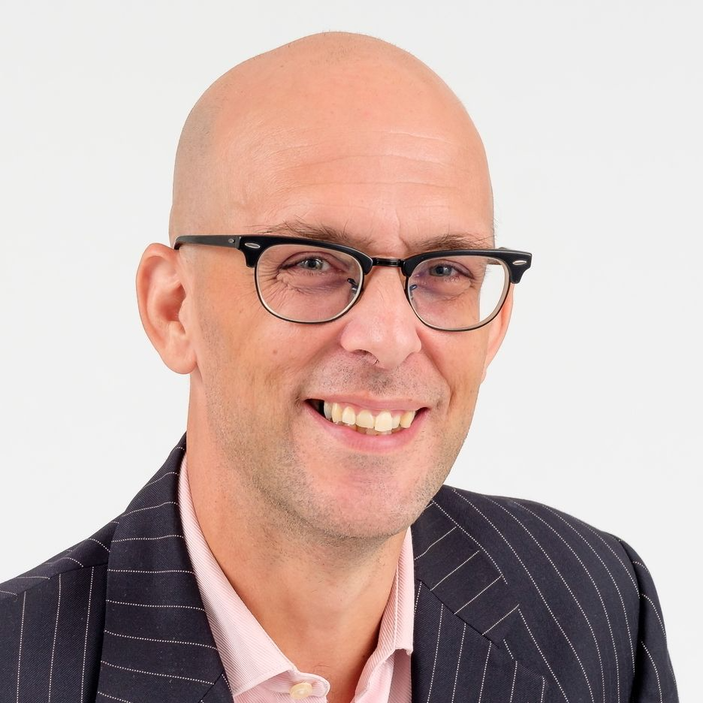

Our team
Dr. Alison Roulstone
Entrepreneurial Lead
Dr. Kinga Morsanyi
Principal Scientific Advisor
Dr. Monalie Bandulasena
Transfer Tech Officer
Dr. Julia Bahnmuller
Advisory Board / Co-I
Cat Eadle & Rob Jennings
Dyscalculia Network CIC
Denis Oakley
Business Advisor

Slide 10
Next steps
NEST
Seeking future investment 50k and business mentorship to develop the online audit assessment tool and training package
Applying for ICURe Explore Jan 2025 to conduct further international market research and test new markets
Neuro Education Solutions Training
Together we can create better futures for all people living with dyscalculia
A.E.Roulstone@lboro.ac.uk

